Slide 1
Costa Rica Experience
Pace University Students: Cirelli, Adrienne; Delaski, Emily; Gargiulo, Paige; Jimenez, Coleen; Jocks, Amanda; Queen, Chelsea; Regan, Erin; Rodriguez, Mariselle and Ruiz, Kelsey

Slide 2
World Health Organization
Defines primary healthcare with five key elements for achieving this goal
Universal coverage reform
Service delivery reform
Public policy reform
Leadership reform
Increasing stakeholder participation

Slide 3
Overview of Costa Rica
Has seven provinces
Population in 2010 was close to 5 million
51% male
Low fertility rate 1.8%
High literacy rate
#1 health concern is cardiovascular disease and trauma

Slide 4
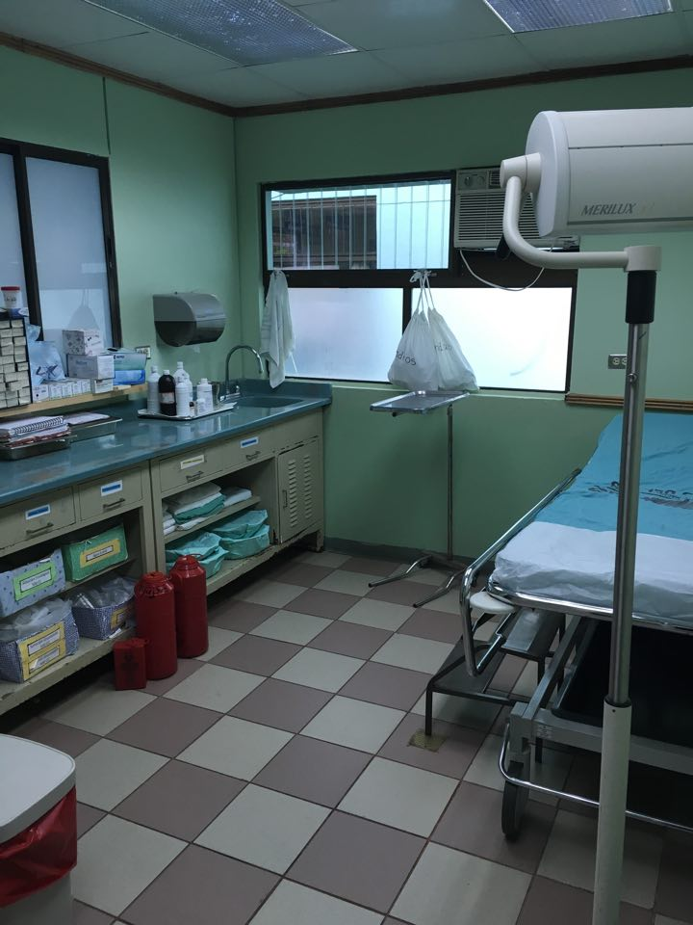
Healthcare System
Every citizen is entitled to free healthcare
Primary Care
Community Clinics
Home visits
Health education
Health promotion
Health Prevention

Slide 5
Healthcare System Cont’d
Secondary Care
Surgery
Specialty needs
Needs referral
Tertiary Care
Treatment
Rehabilitation
Needs referral

Slide 6
Health Promotion/Prevention
Promotion
Proper nutrition
Exercising
Stress management
Smoking cessation
Prevention
Teen pregnancy
Addiction
Domestic violence
Chronic diseases
Cancer

Slide 7
Monteverde in Motion

Slide 8
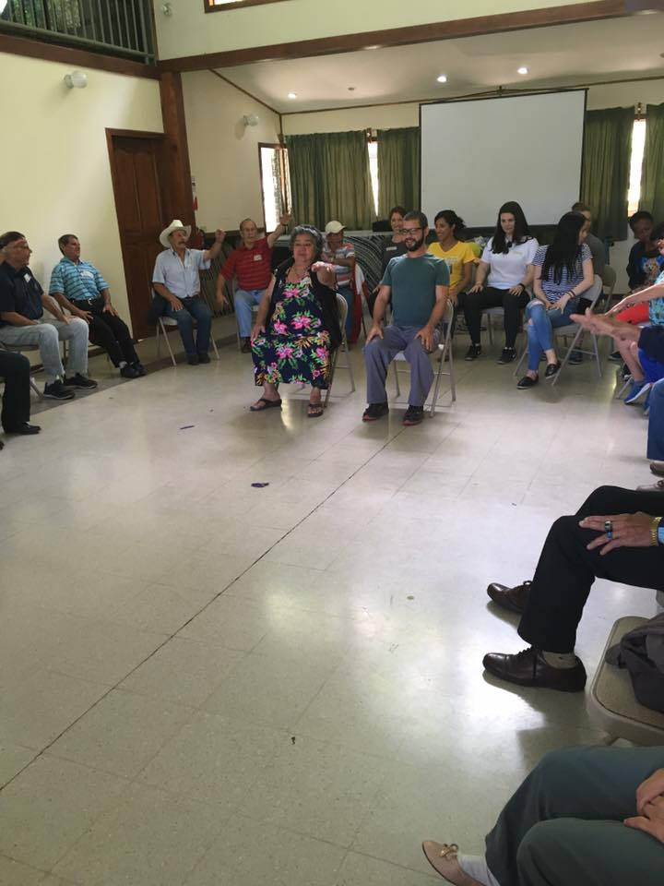
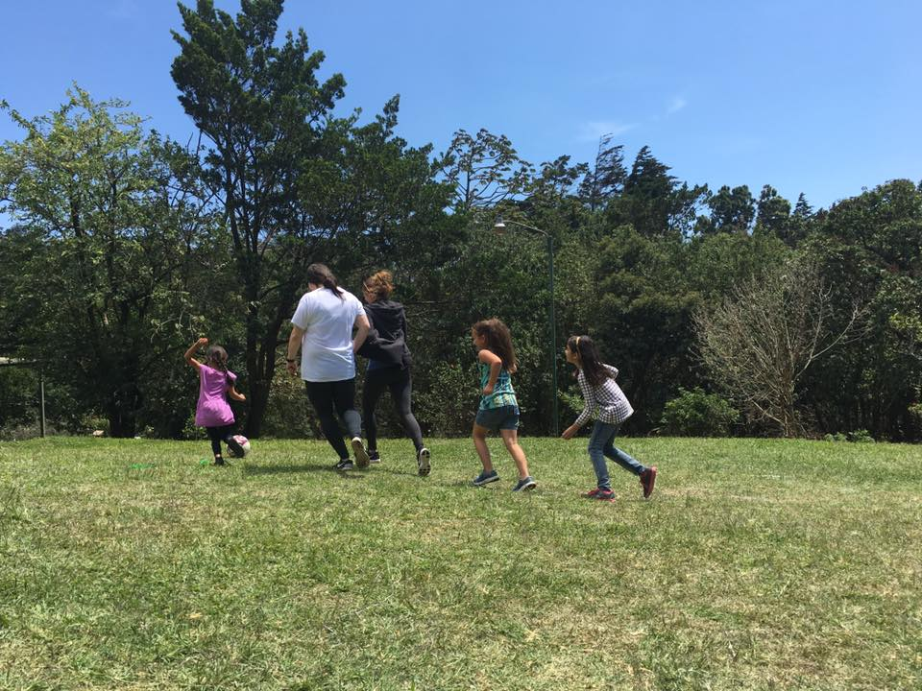
Healthy Activities

Slide 9
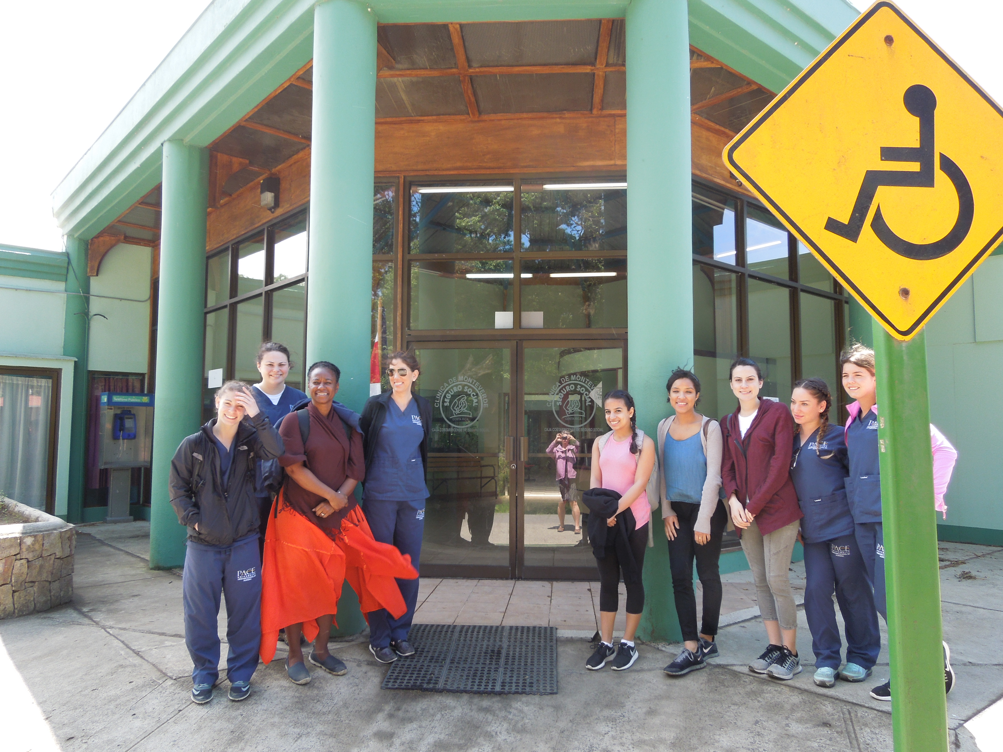
Basic Healthcare Team
Physician
Pharmacist
Nurse
Secretary
Technician

Slide 10
Accomplishments for Costa Rica’s Healthcare System
100% vaccination of all children one and younger
97% Antenatal compliance
4 or more visits
Low infant mortality rate
9.46/1,000
Low maternity mortality rate
2.11/100,000
High life expectancy rate
79.3
Healthcare expenditures is 10.5% of the GDP

Slide 11
Monteverde
Conservation
Research
Quaker Village
Economic Zone
Milkshed
Biological (Cloud Forest)
Epiphytes
Seismic Activity
Gray Water
Biogarden
Tourist Attraction

Slide 13
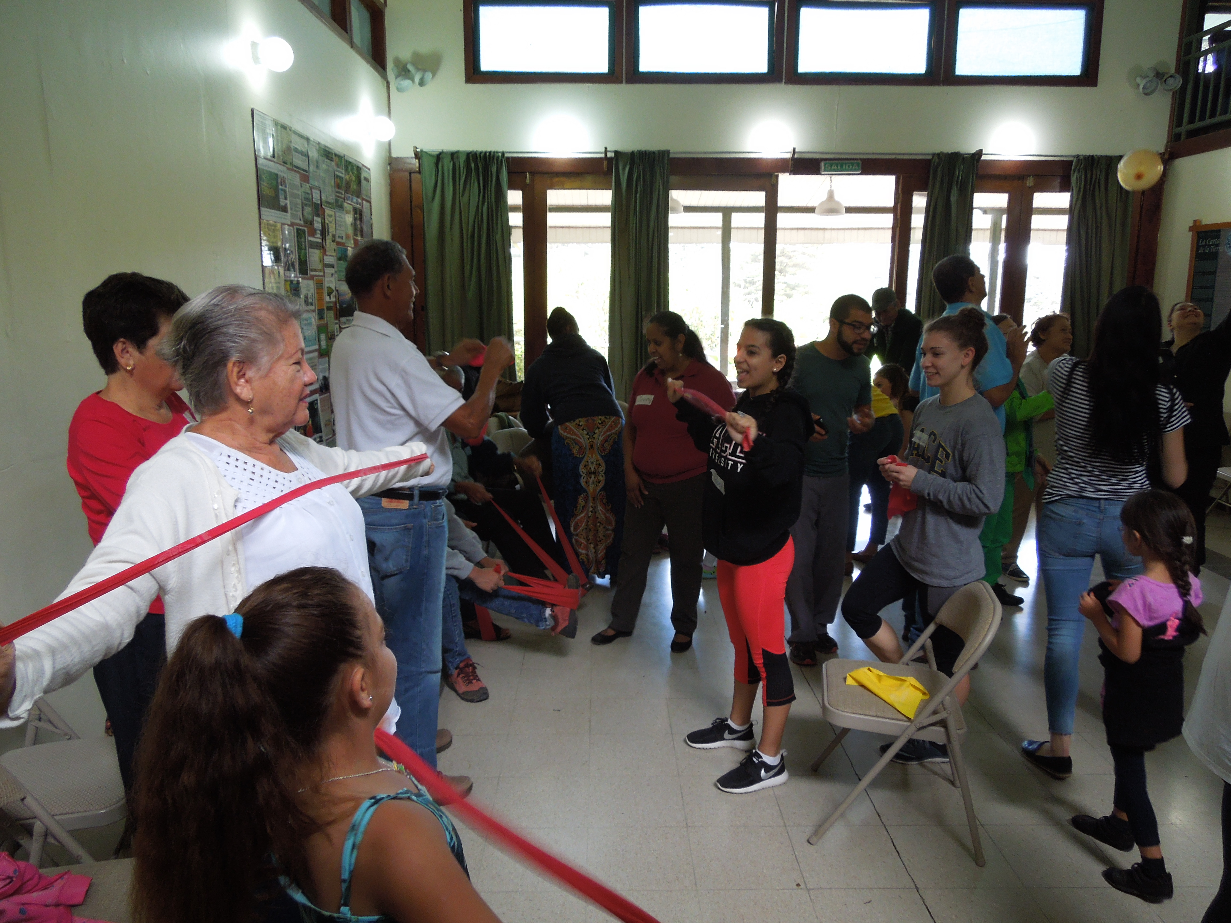
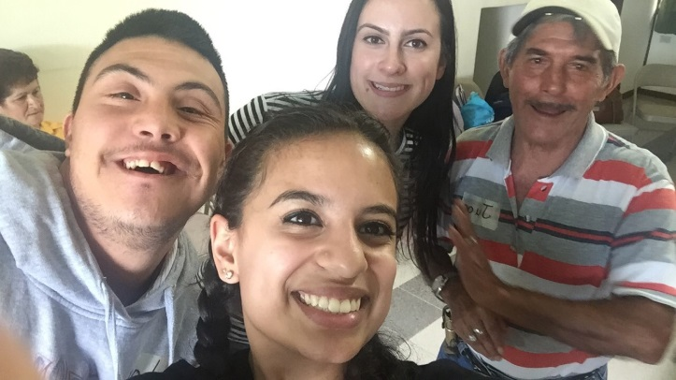
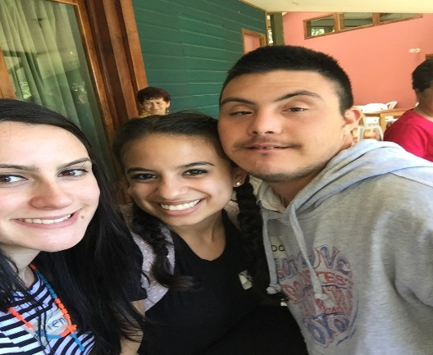
Communications Sciences & Disorders Perspective
Adult group activity
The Monteverde Institute follows the Life Participation Approach for the elderly.
The Life Participation Approach (LPA) is a consumer-driven service-delivery approach that supports elder individuals and others affected by aging, when achieving their immediate and longer term life goals.
LPA calls for a broadening and refocusing of clinical practice and research. All adult group activities has focused on re-engagement in life.

Slide 14
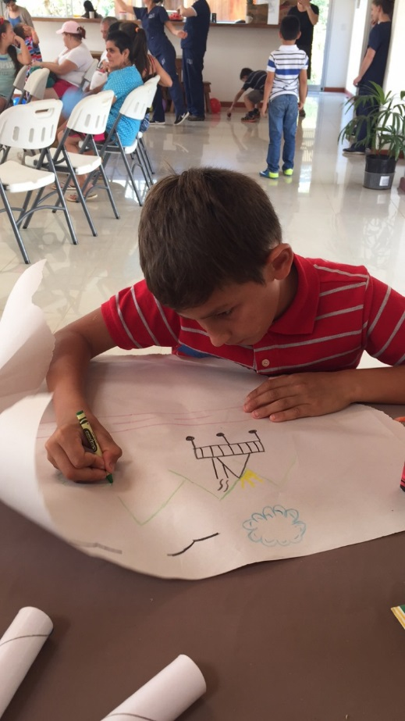
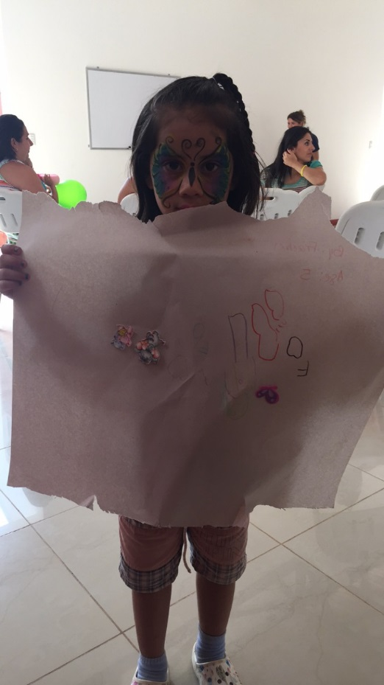
Communications Sciences & Disorders Perspective
When interacting with children, we asked them to perform nonverbal tasks (draw a picture) in order to assess cognitive abilities
As they performed the activity, we took notice of the child’s artwork
Nonverbal tasks relates to nonverbal intelligence
It assesses the child’s ability to analyze information and solve problems using visual and hands-on reasoning

Slide 15
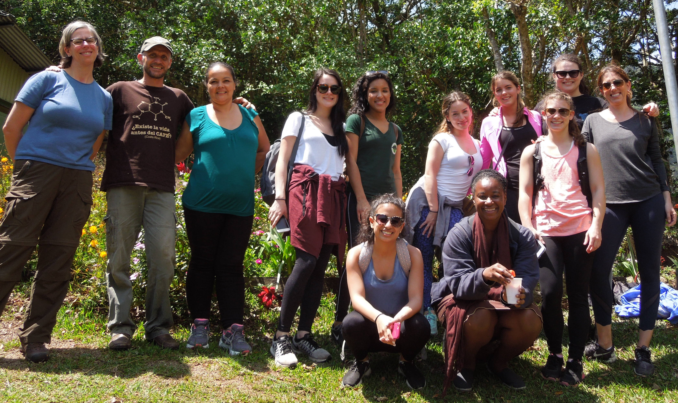
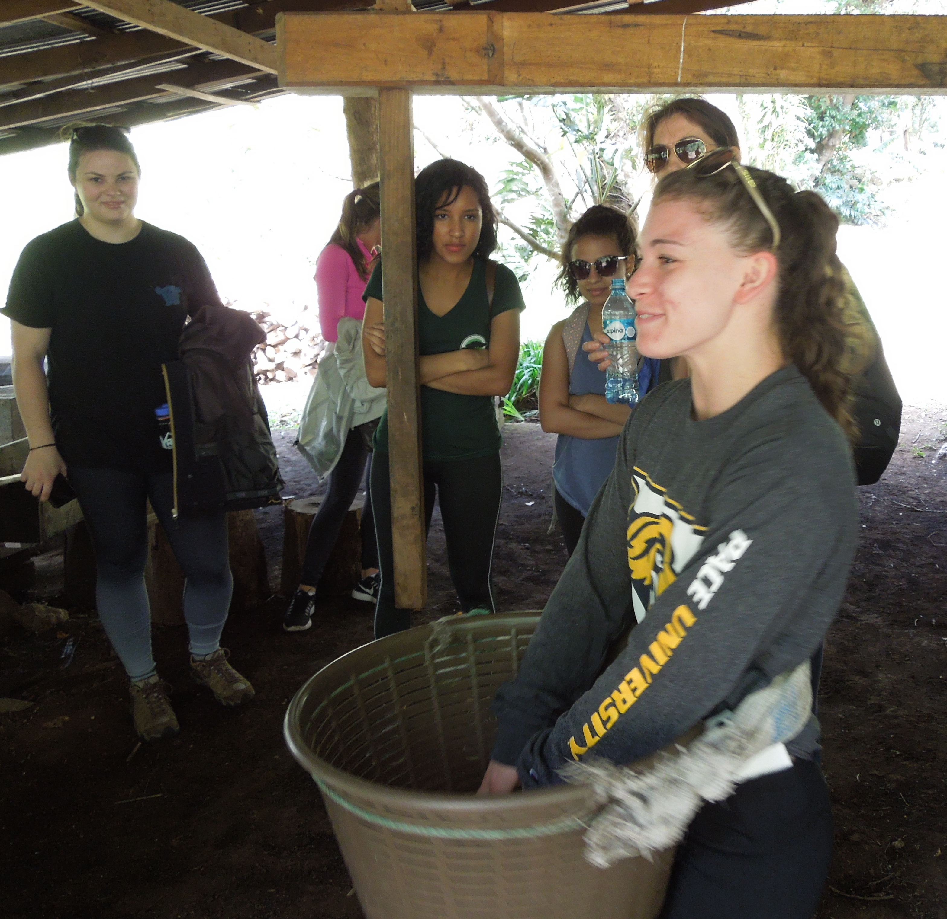
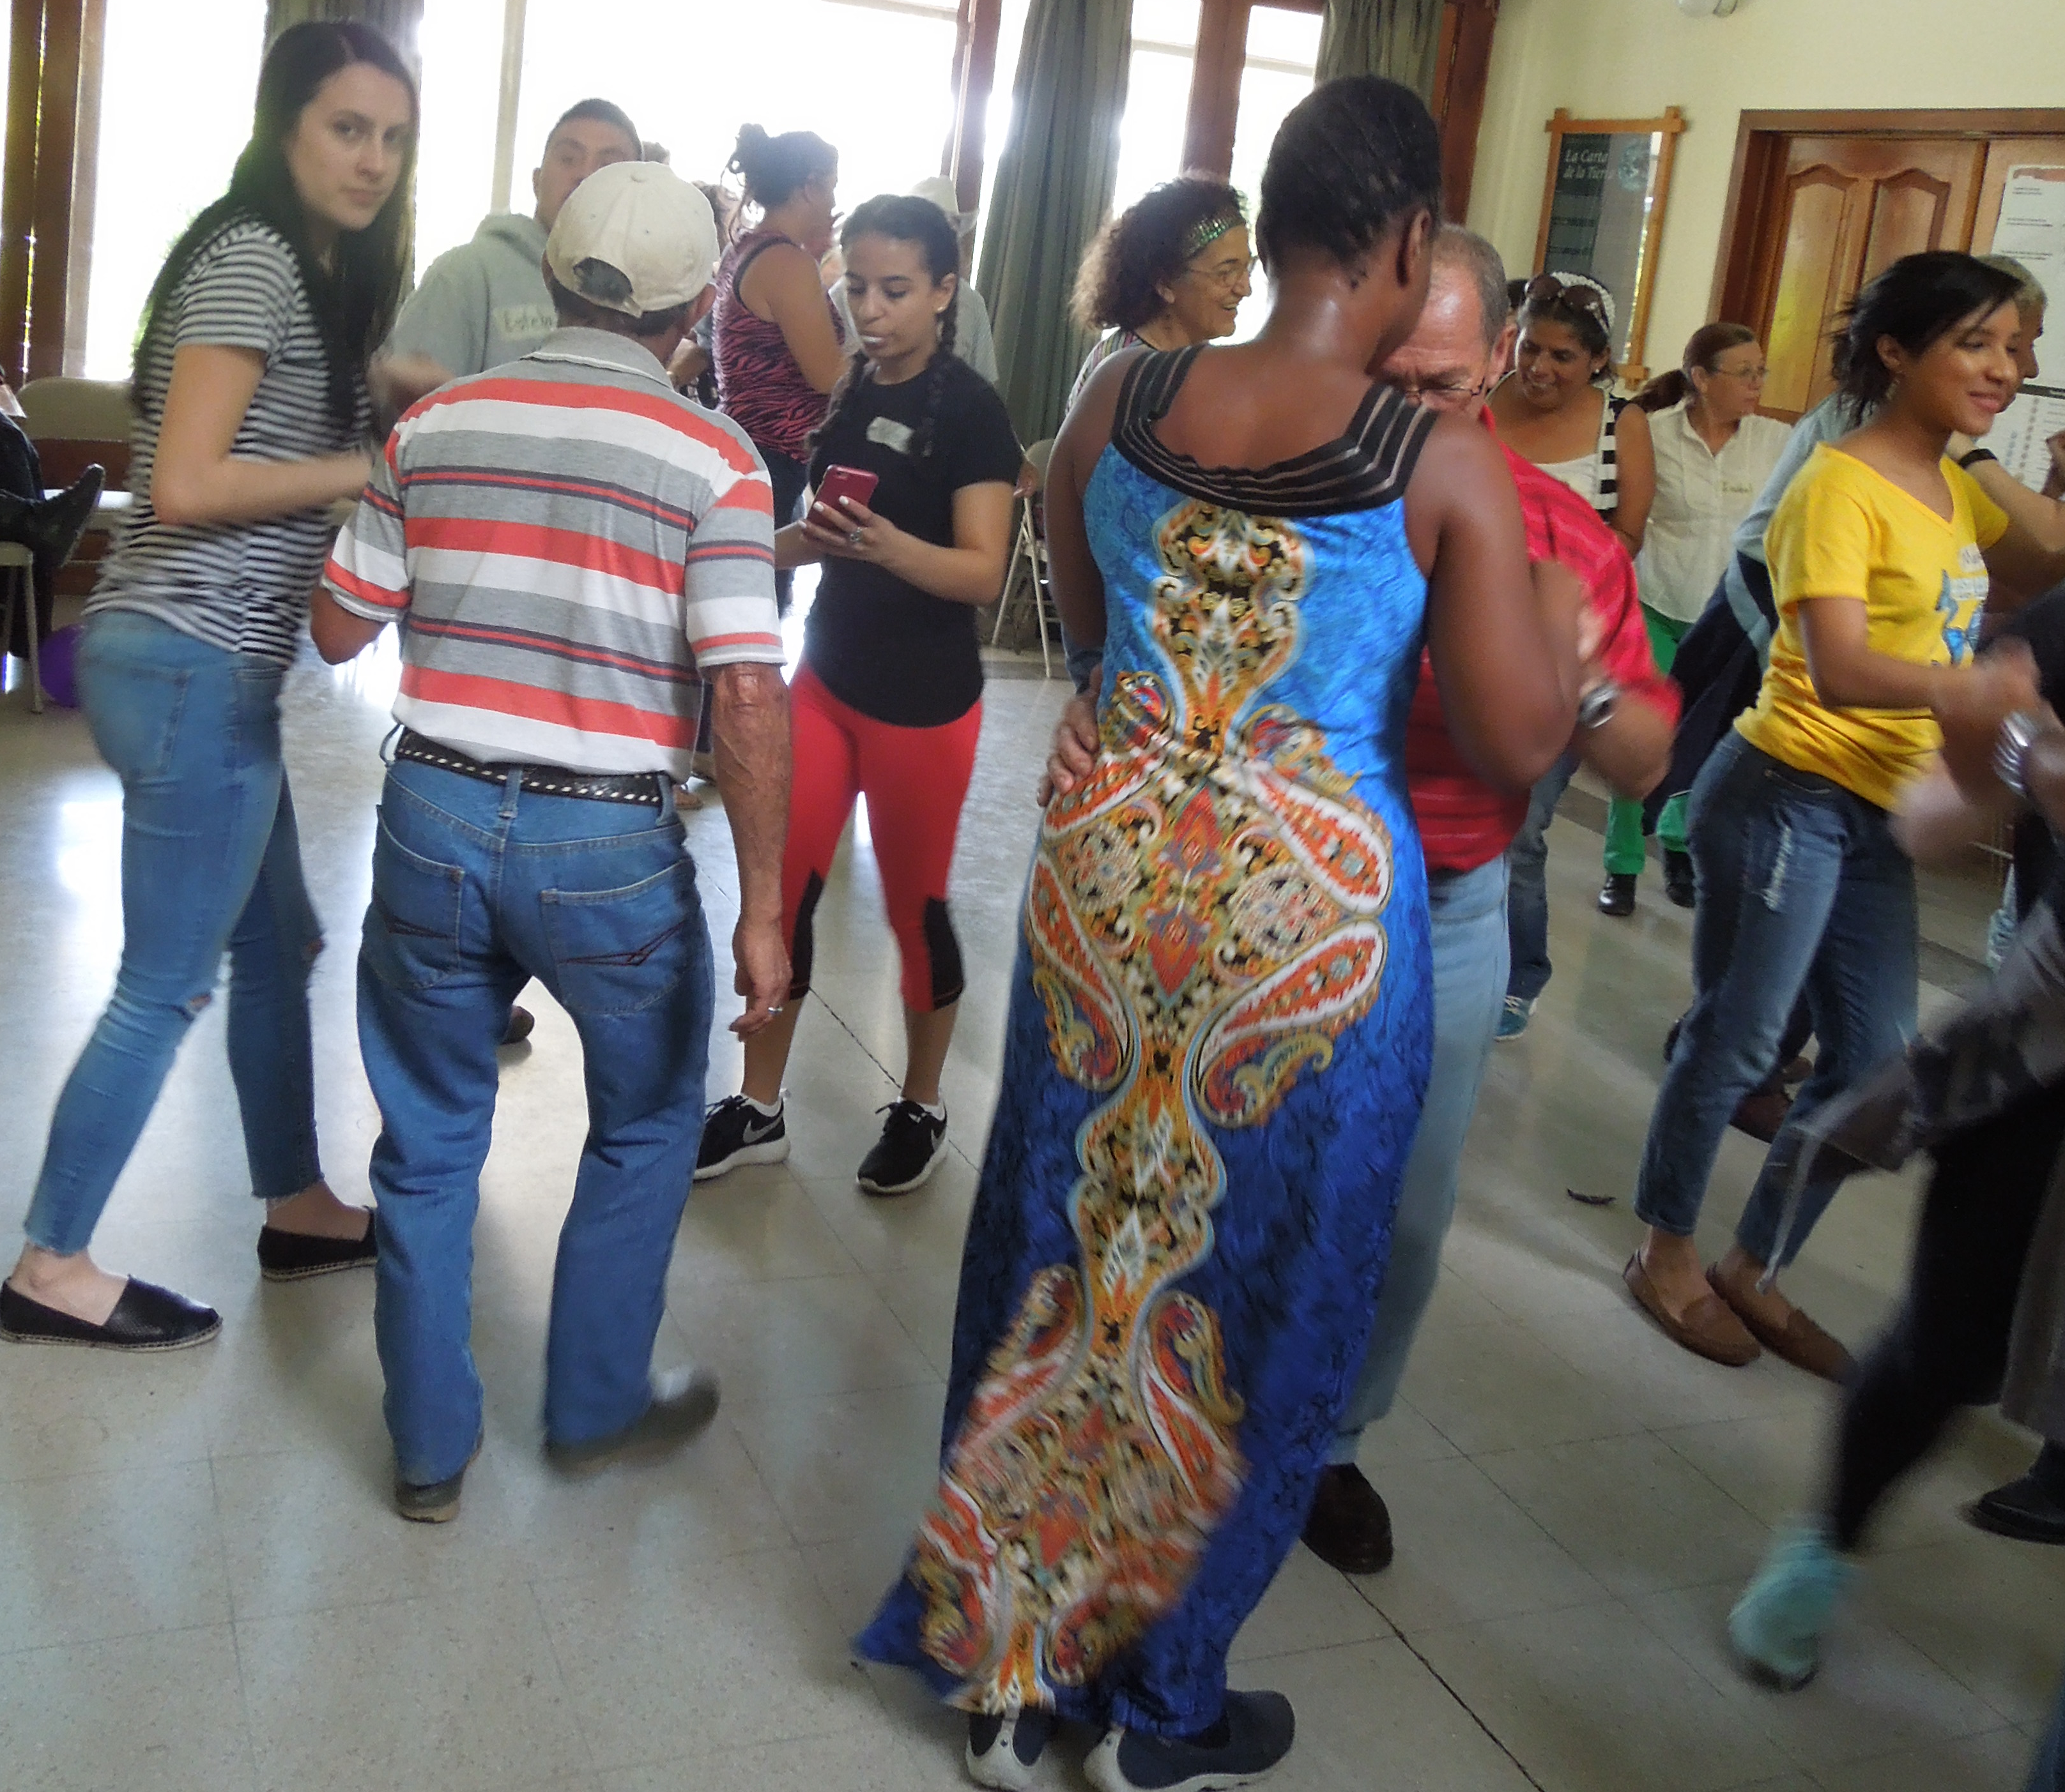
Costa Rica Impact on Us
Community Involvement
Slow down
Holistic Care
Simplicity
Balanced lifestyle

Slide 16
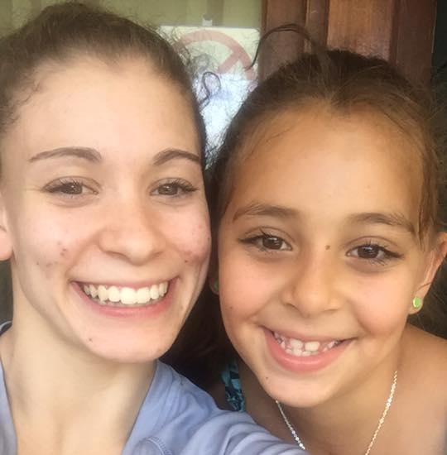
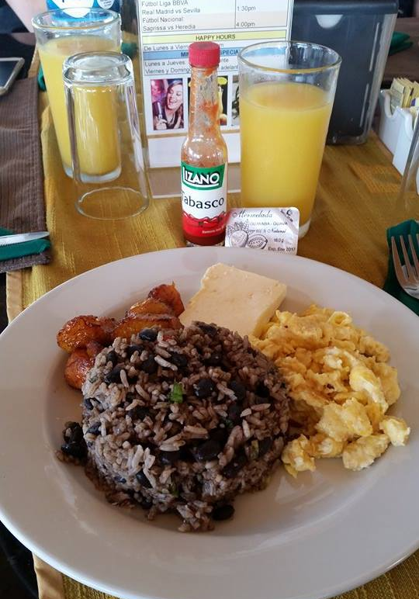
Pura Vida

