Slide 1
Child Family Health International
Healthcare Challenges - Cape Town, South Africa
Pace University-Lenox Hill Hospital Physician Assistant Program – Class of 2016
Ramiz Desai
Yasmine Elraheb
Eric Ma
Marina Makarious

Slide 2
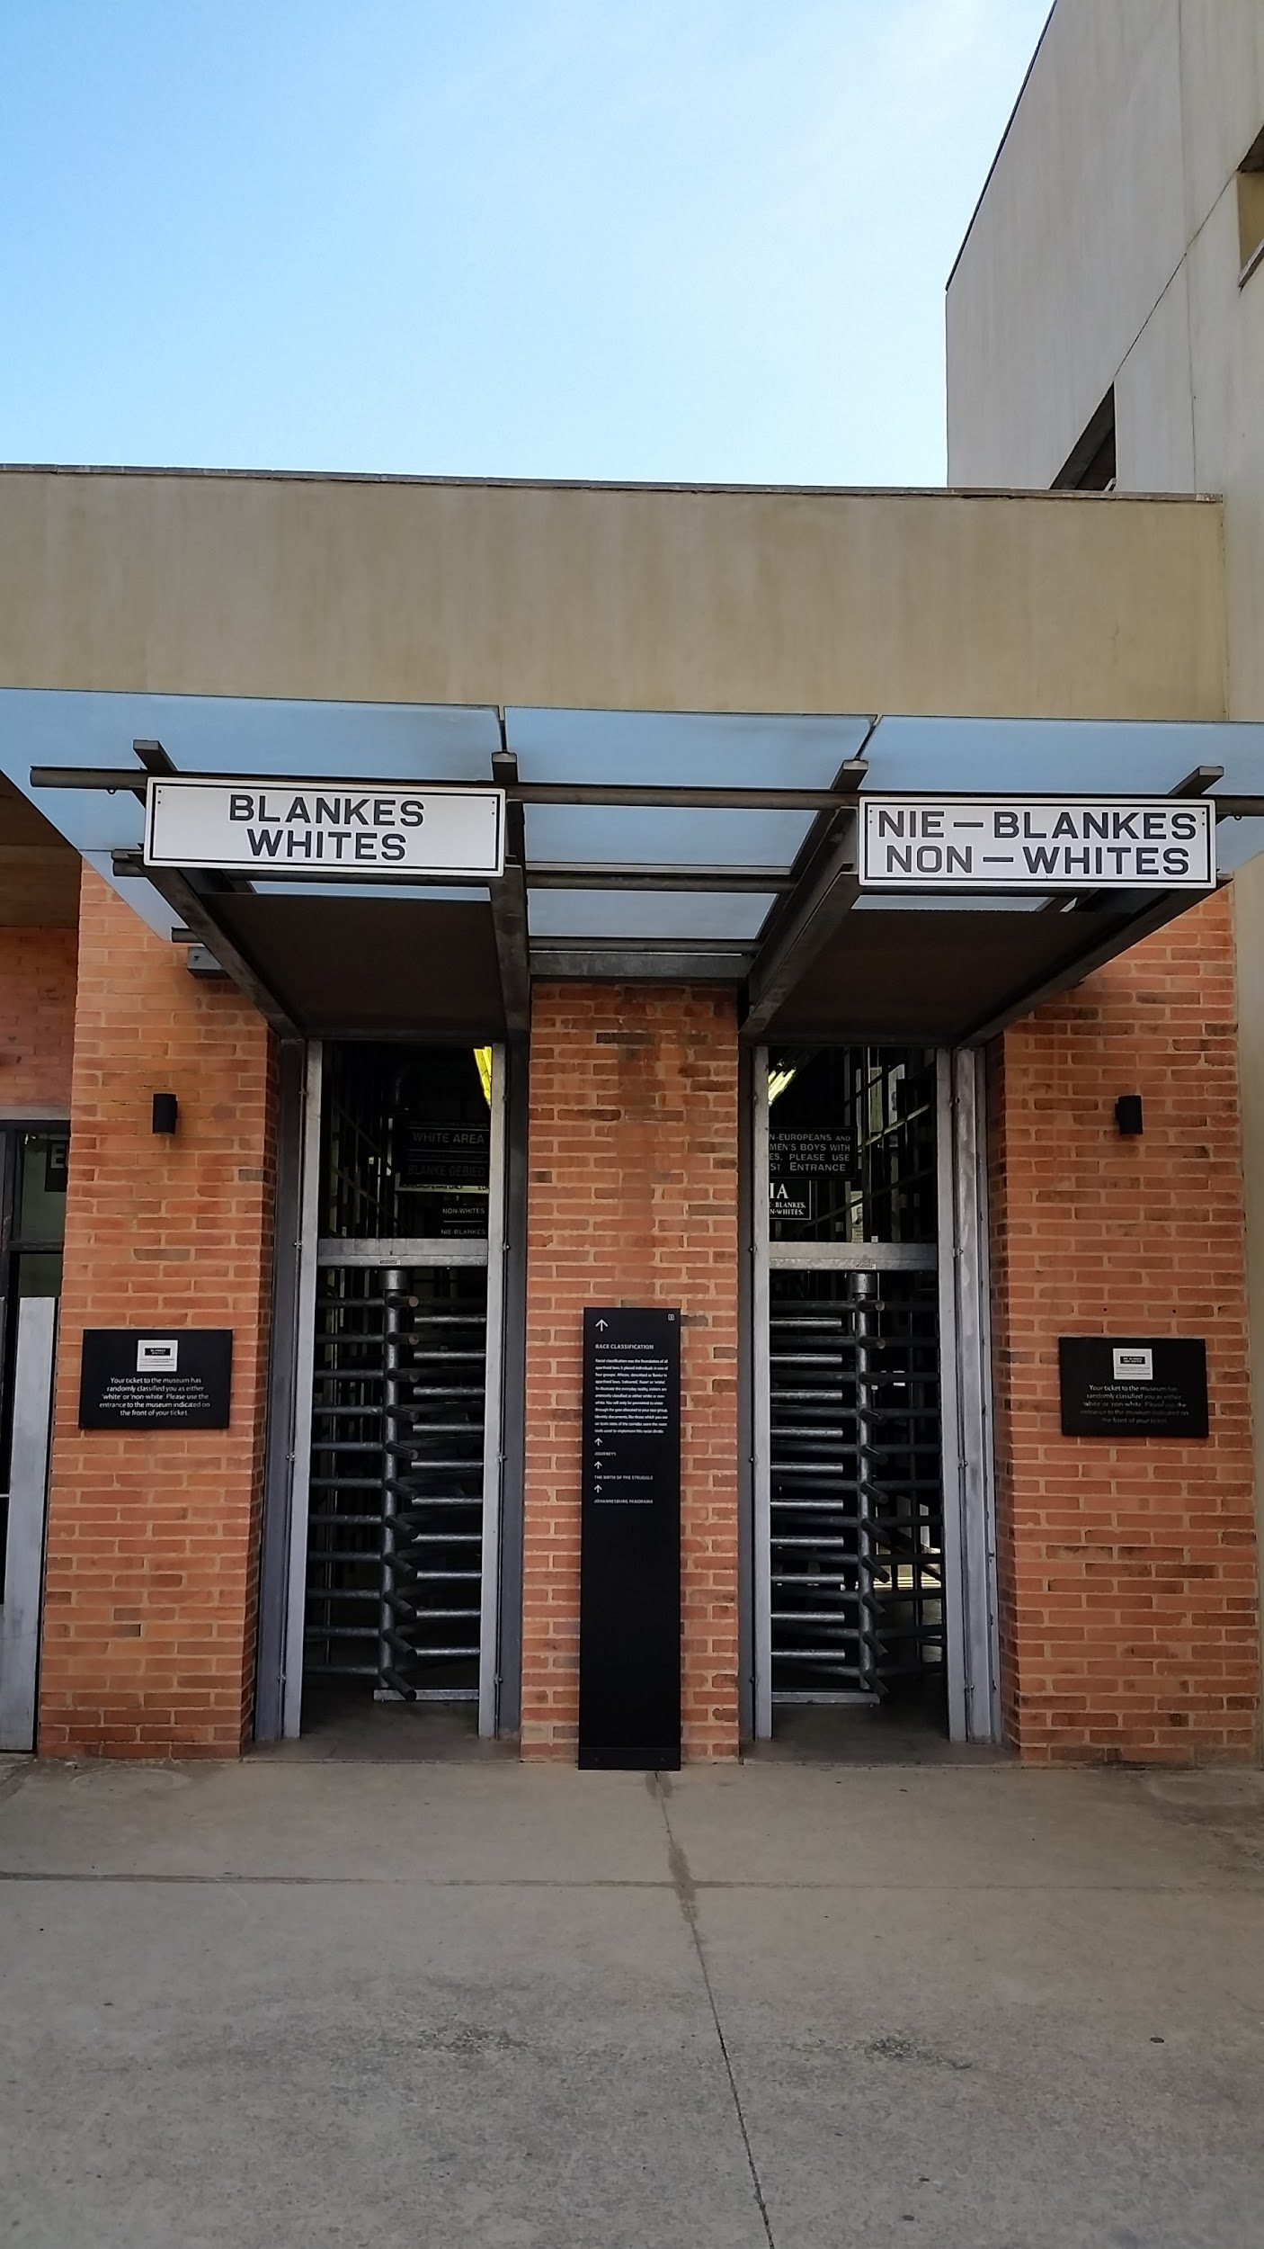
Brief History of South Africa
Colonized by the English and Dutch in 17th century
Discovery of natural resources around 1900
Mineral resources (gold, diamond, platinum)
Boer War - English vs. Afrikaners (Dutch descendants)
Land mines
Apartheid
A means to establish control over the economic and social system
Racial discrimination with territorial separation and police repression
Melting pot
South Africans of European, African, Malaysian, Indonesian, Indian, and other mixed race descent
12 different languages spoken (most common: English, Afrikaans, Xhosa, Zulu)
Today, disparity persists despite the end of Apartheid and segregation laws

Slide 4
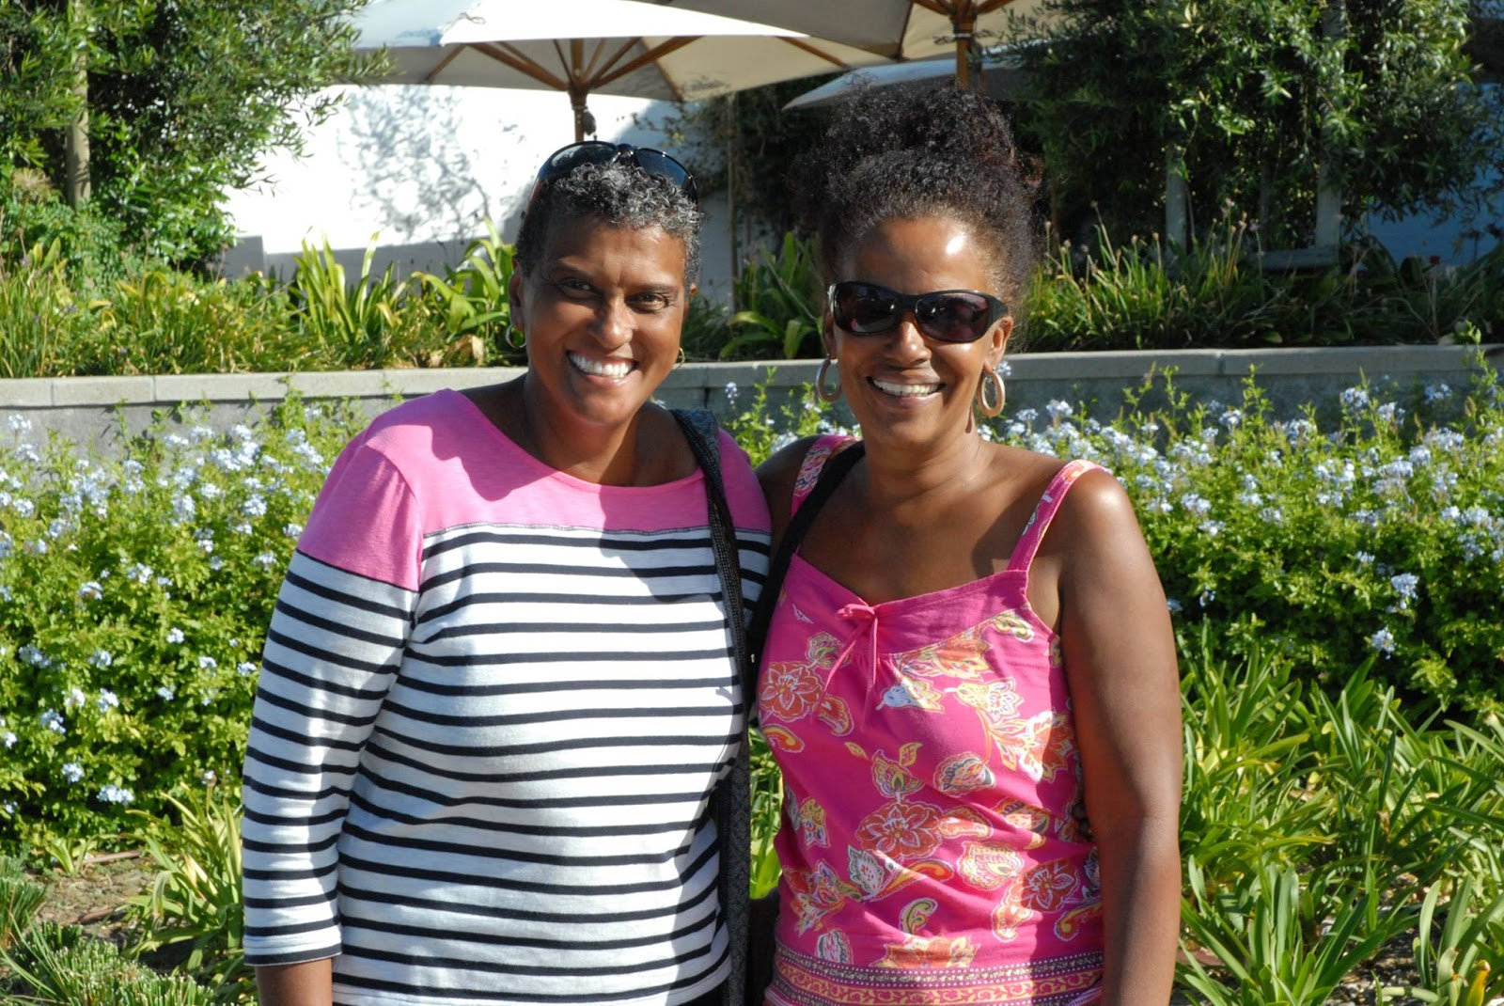
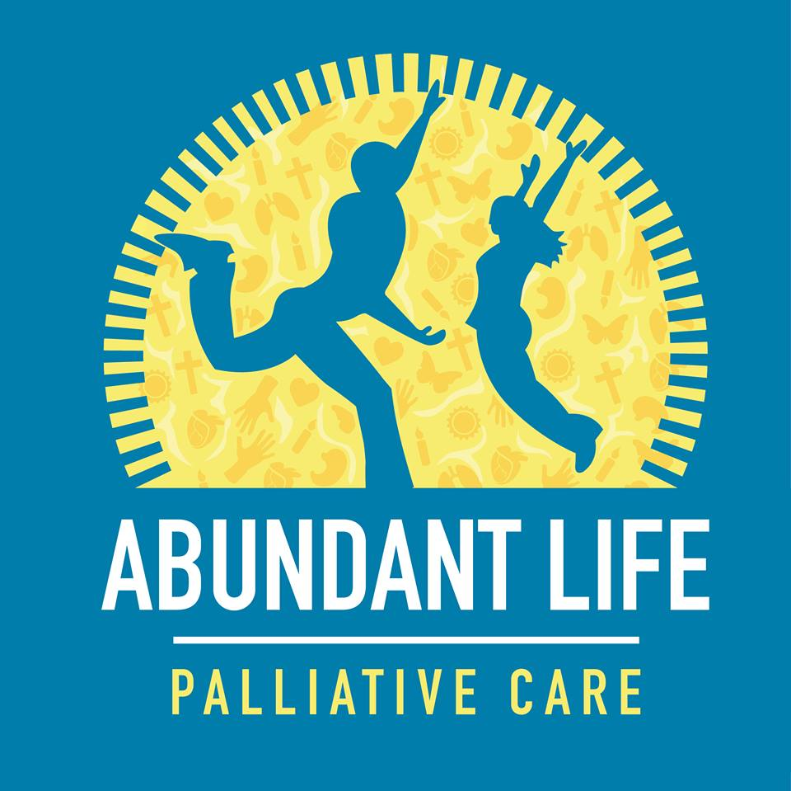
Child Family Health International
NGO recognized by the U.N. and W.H.O
Community based global health education program
Over 50% of the fees go to our homestays and hospitals
e.g. Abundant Life Palliative Care
Avril and Marion

Slide 5
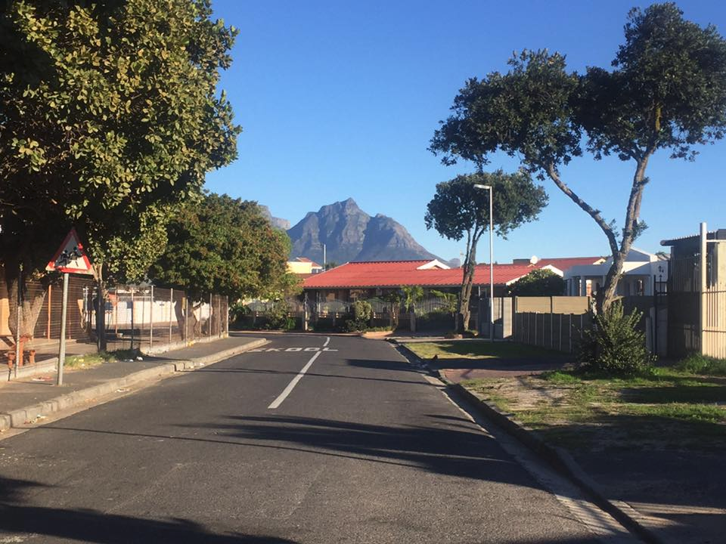
Our Homestays
Cape Flats, Vanguard Estate
The Loedwyks
Carol - housewife, former teacher
George - high school teacher
The Jappies (Cape Malay)
Soraya - self-employed, MBA
Ashraff - self-employed photolithographer
Uncle and Auntie Mammoth

Slide 6
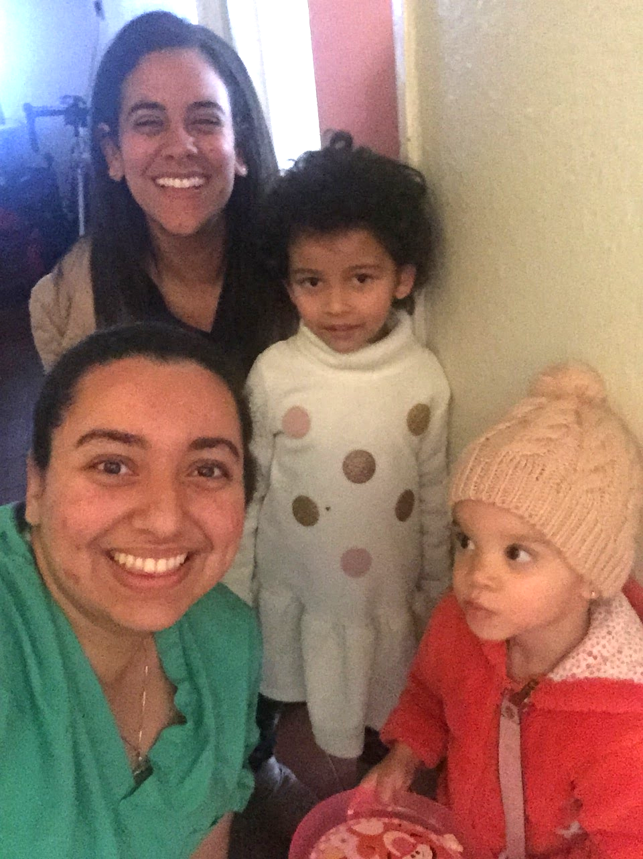
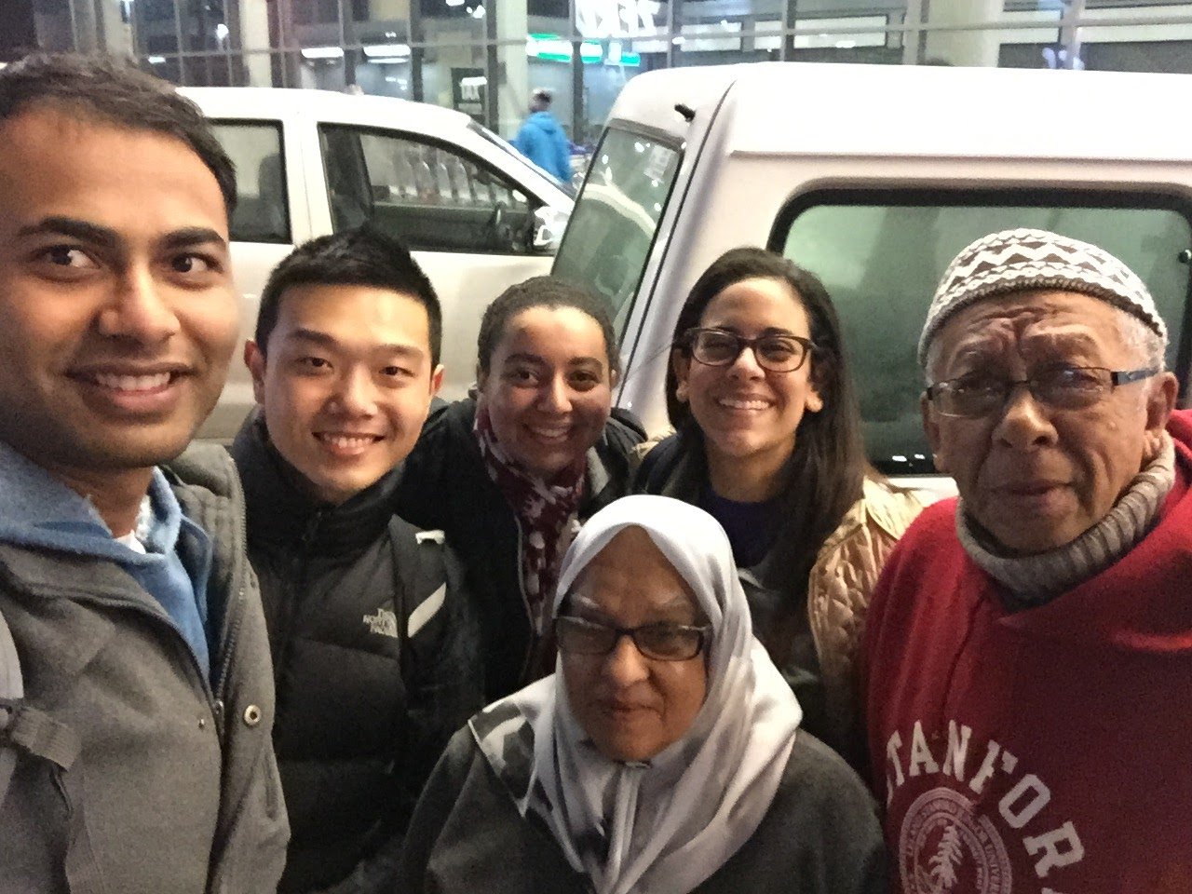

Slide 7
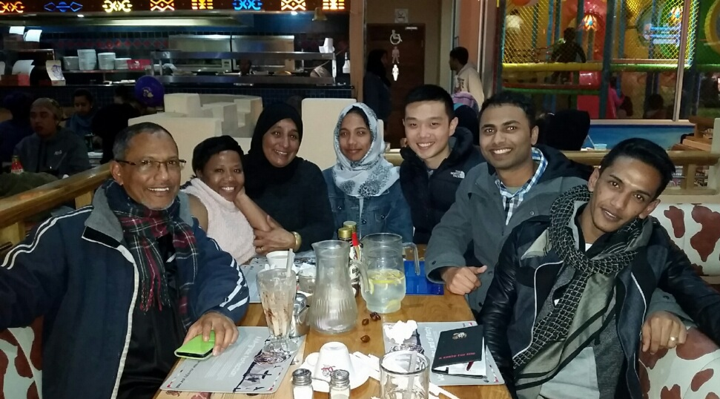

Slide 8
Why South Africa?
Healthcare Challenges in Cape Town
Highly recommended by previous students
Diverse patient population
English speaking country
Health disparities intertwined with culture, socioeconomic status, and history
Beautiful country with many natural landmarks and attraction sites

Slide 9
Healthcare in South Africa
Private Sector
Public Sector
Community Health Center
“Day Hospital”
Secondary Hospital
e.g. Victoria Hospital
Tertiary Hospital
e.g. Groote Schuur
Clinical Associates - equivalent of PAs in the health sector

Slide 10
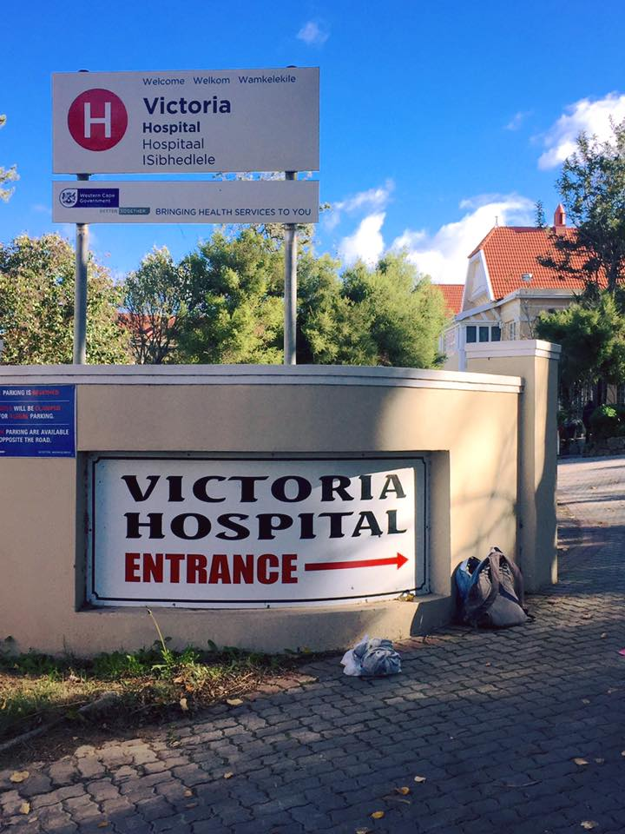
Victoria Hospital
Secondary Teaching Hospital
Approximately 158 inpatient beds
50% of patients uninsured
Private insurance
Serves about 47,000 patients a year
Patient Population
Primarily “colored” and “black”
Low- Mid Socioeconomic status

Slide 11
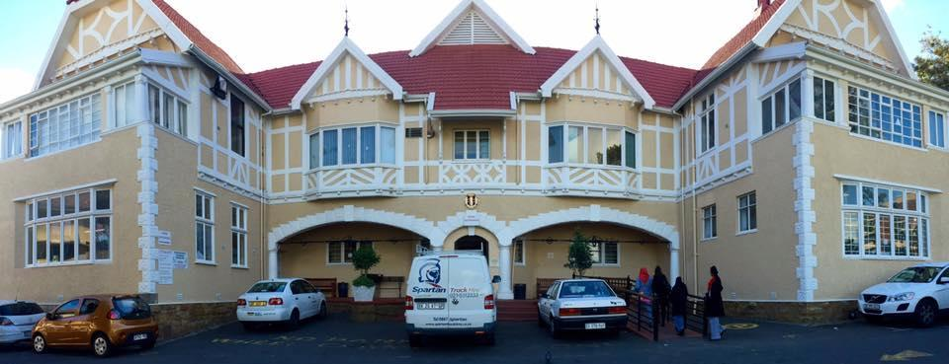

Slide 12
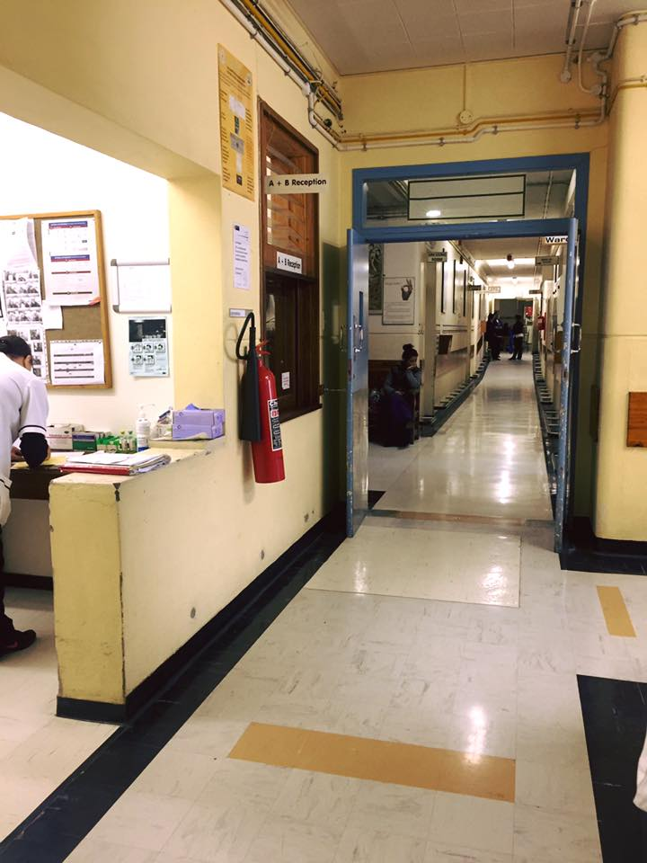
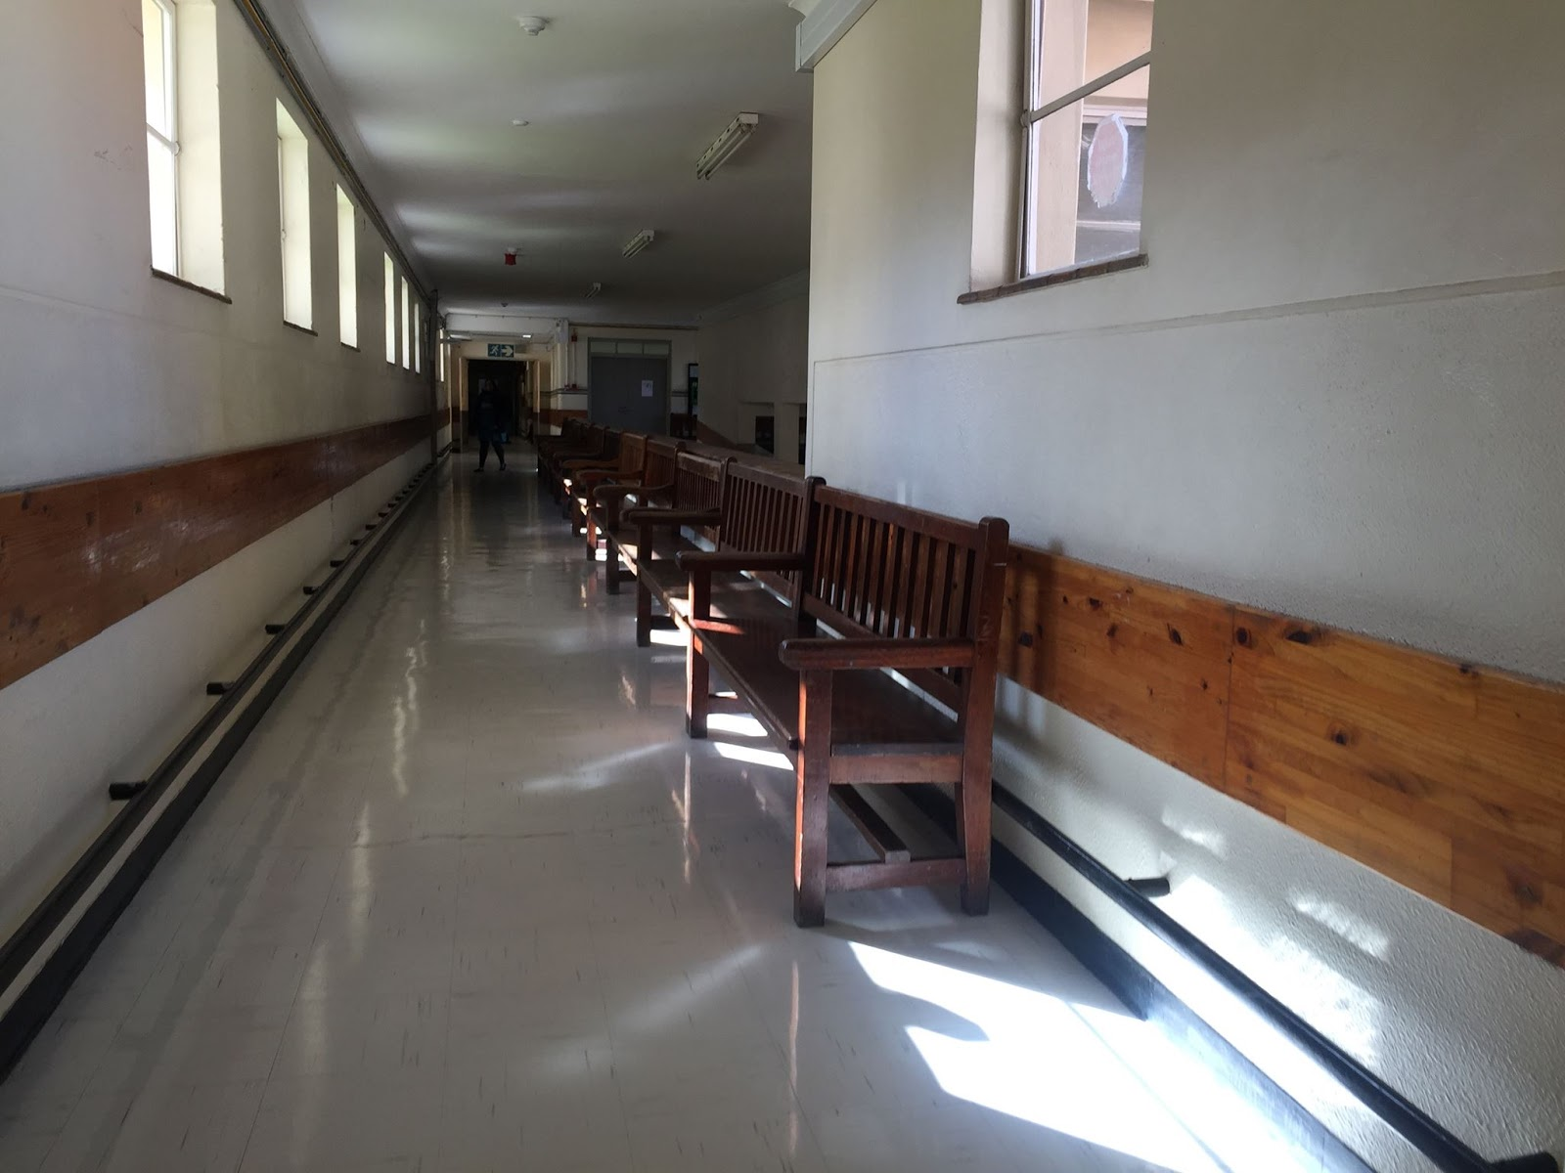

Slide 13
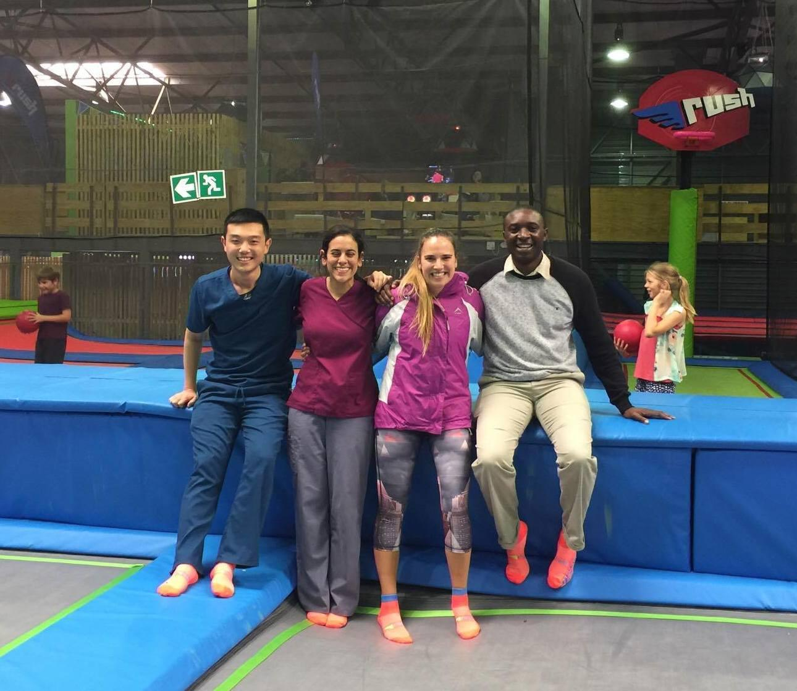
Internal Medicine Department
5 “firms” and 2 consultants
Registrar, Intern, Students
Daily ICU rounds
Ward rounds with firm
Male and female medical wards
TB ward
Clinic
MOPD
Diabetes
Weekly Infectious Disease rounds
Weekly Journal Club
On-call every 5 days
Post-call rounds with consultant

Slide 14
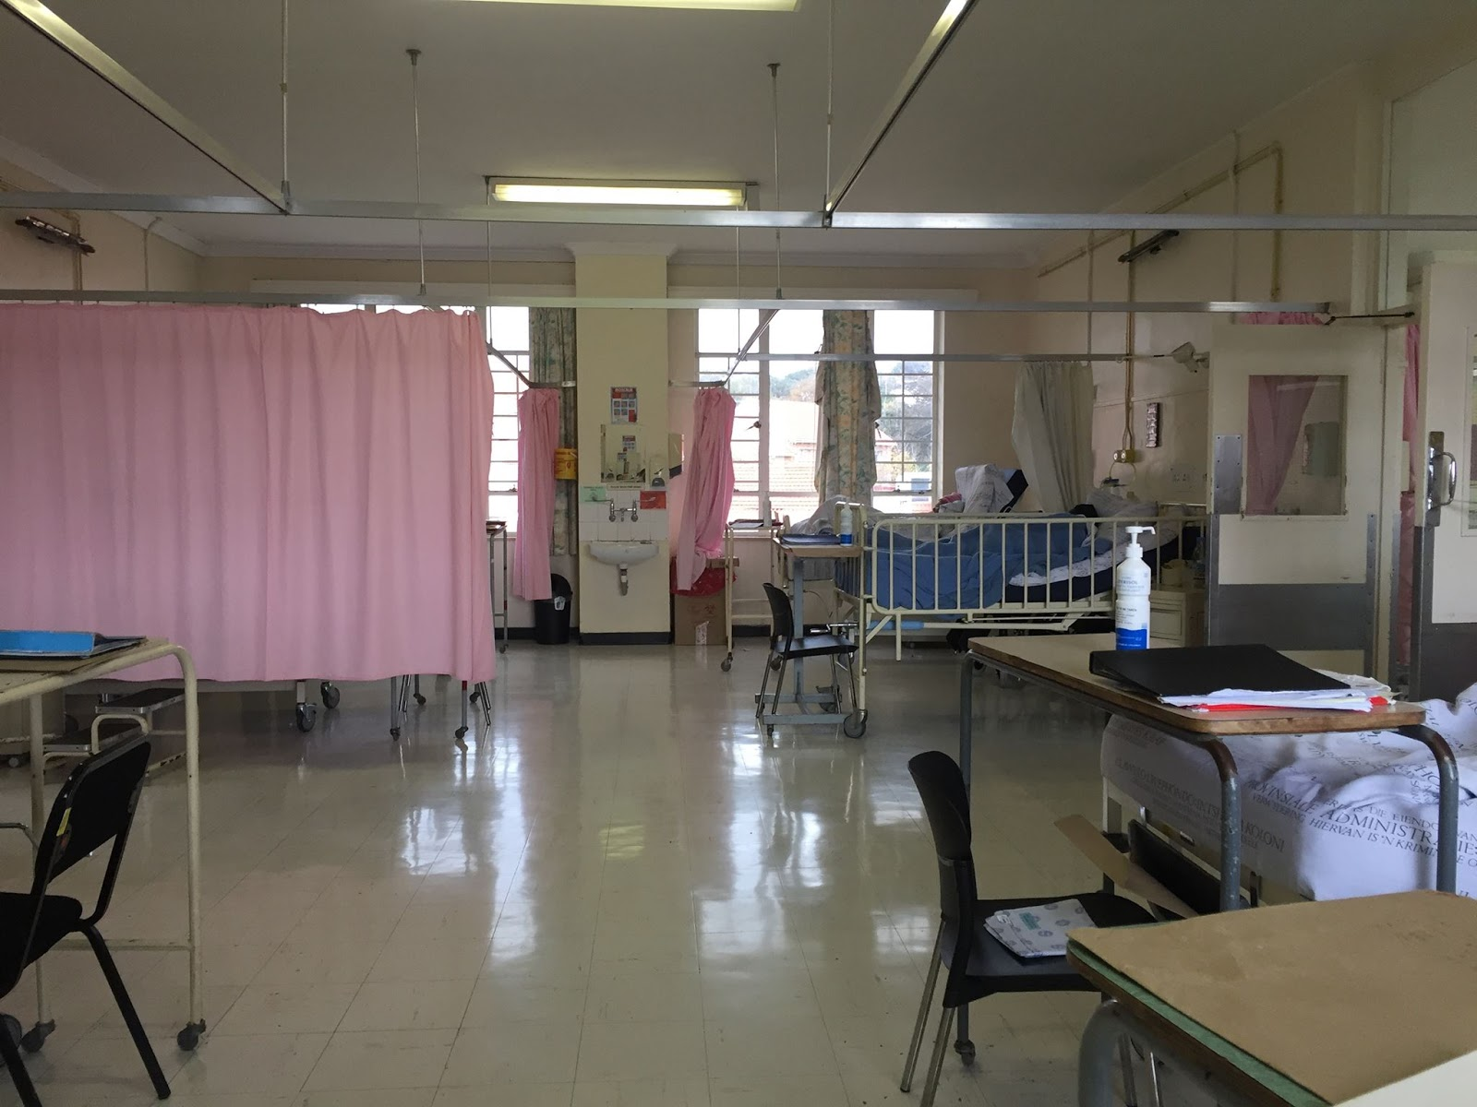
Internal Medicine
Chronic Conditions
Heart disease: STEMI, NSTEMI, heart failure
Diabetes mellitus
Hypertension
Chronic kidney disease
Liver disease
Malignancy
CVA
Infectious Diseases
HIV/AIDS
Tuberculosis
Cryptococcal meningitis
Varicella pneumonia

Slide 15
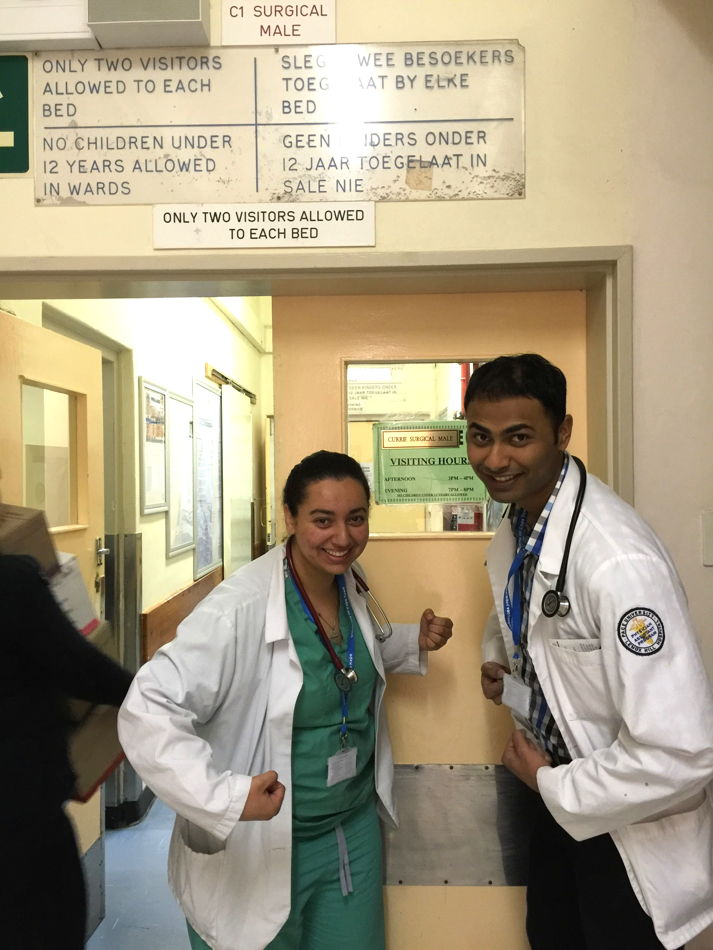
Surgery Department
Daily morning ward rounds
2 Interns, 2 Registrars, Jr./Sr. Consultants, Sisters (nurses) & students
Male vs. Female surgical wards
Minor Ops
I&D, D&Cs, Biopsies, Sigmoidoscopies
“Theater” - aka Operating Room (OR)
Lap Choleys, Hernia repairs, “toe-ectomies”
Stab wound explorations, mastectomies, TURPs

Slide 16
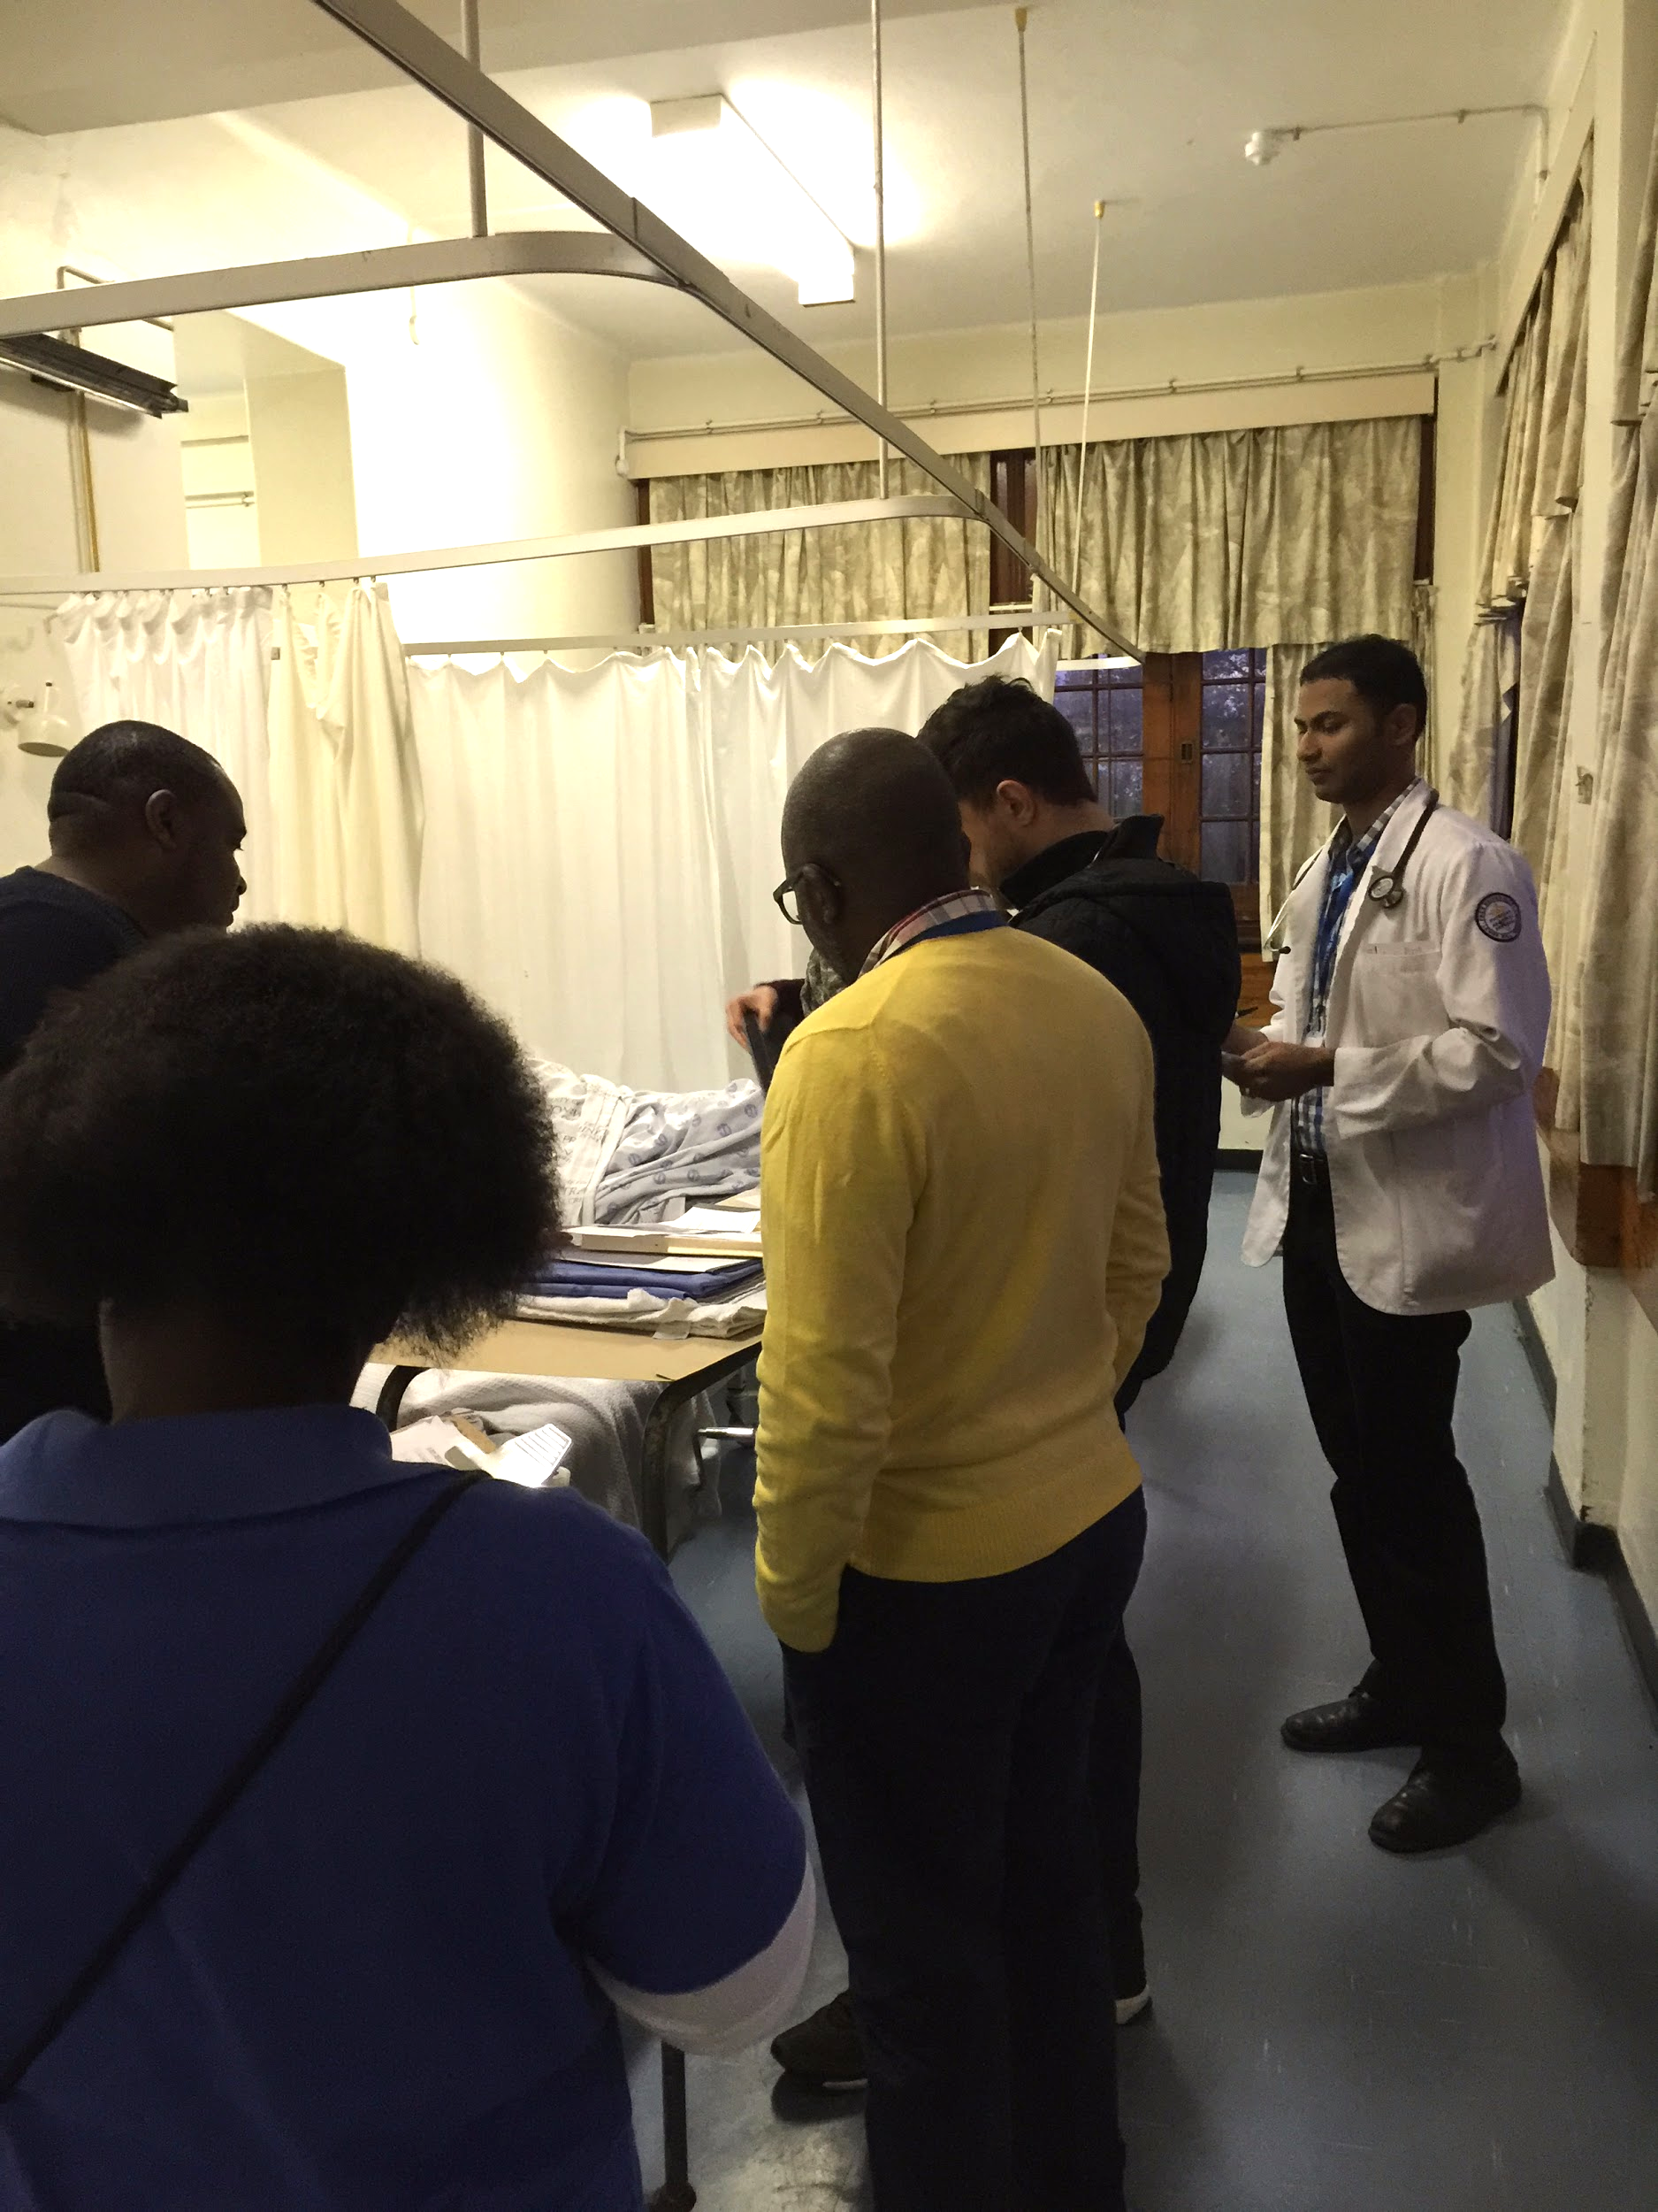
Surgery Department
Gastrointestinal Unit
G-scope, C-scope
Casualty (emergency department) consults
Dressing Room
Wound checks
Late stage diseases
Weekly Clinic – Patient population
GSH referrals – CT, ERCP

Slide 17
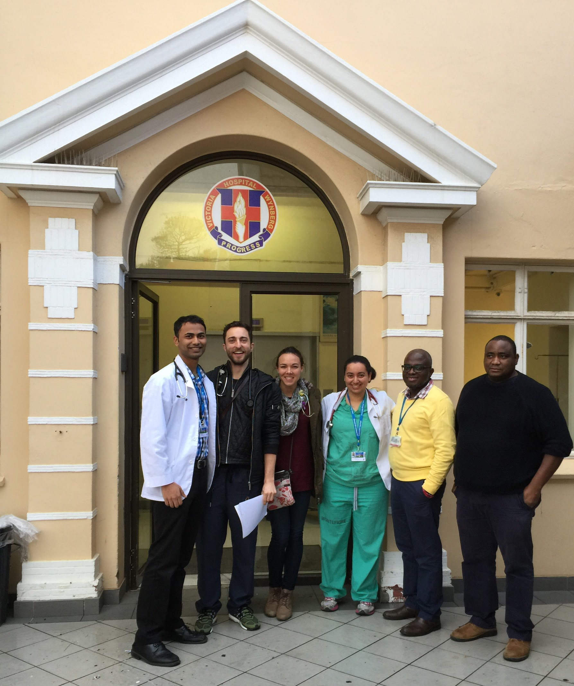
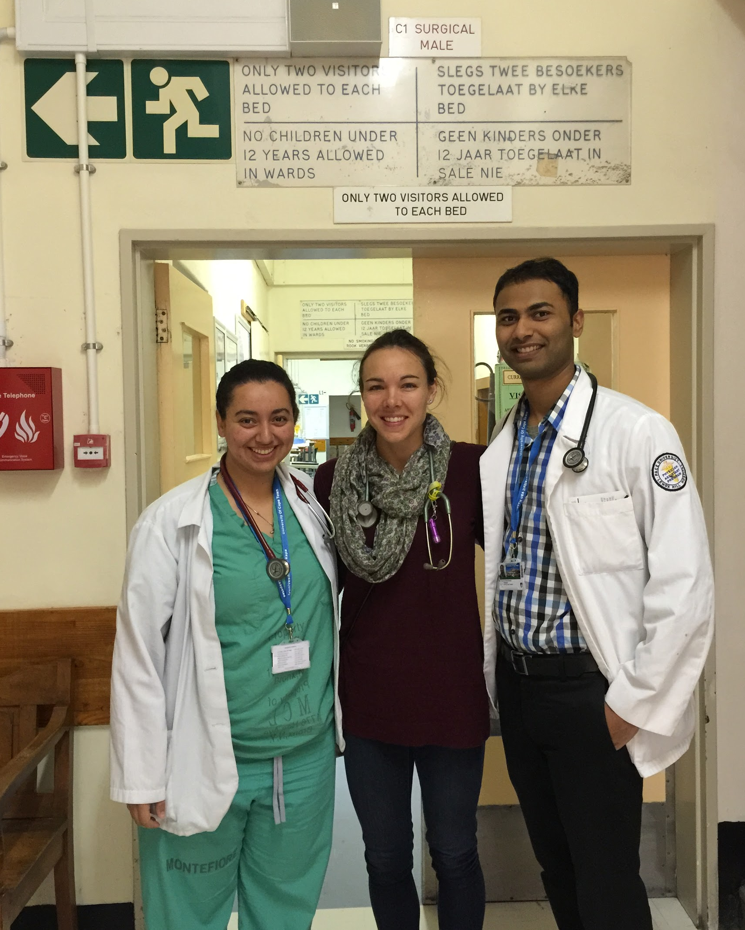
Surgery Team

Slide 18
South African vs. U.S. Health System
Lack of resources
More reliance on physical exam skills and clinical judgement
No CT scan at Victoria Hospital
Limited access to dialysis
No EMR
Communication between facilities and continuity of care
No negative pressure rooms (TB)
Heparinized tubes for VBG/ABG
Abdominal paracentesis for ascites
Sterility/Instrument reusage
No screening guidelines (i.e. colonoscopies, mammograms)
“Sisters” (nurses) - different scope of practice
Long waiting times for patients

Slide 19
Impactful Moments
Respecting patients’ decisions
75 year old female with PAD presenting with bilateral leg gangrene
Limitation to hemodialysis
33 year old male with Stage 5 CKD unable to receive hemodialysis

Slide 20
Exploring Cape Town and South Africa!
Garden Route
Bungee Jumping, Ziplining, Ostrich farm, Elephant game reserve
Bo Kaap
Robben Island
Lion’s Head
Table Mountain
Cape Point/Cape of Good Hope
Hout Bay
Camps Bay
Kalk Bay
Boulder’s Beach
Groot Constantia Wine Estate
Safari - Johannesburg

Slide 21
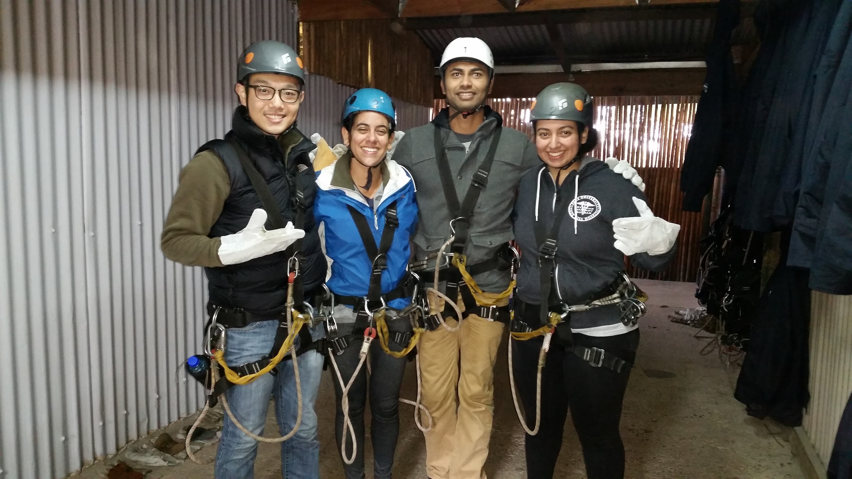
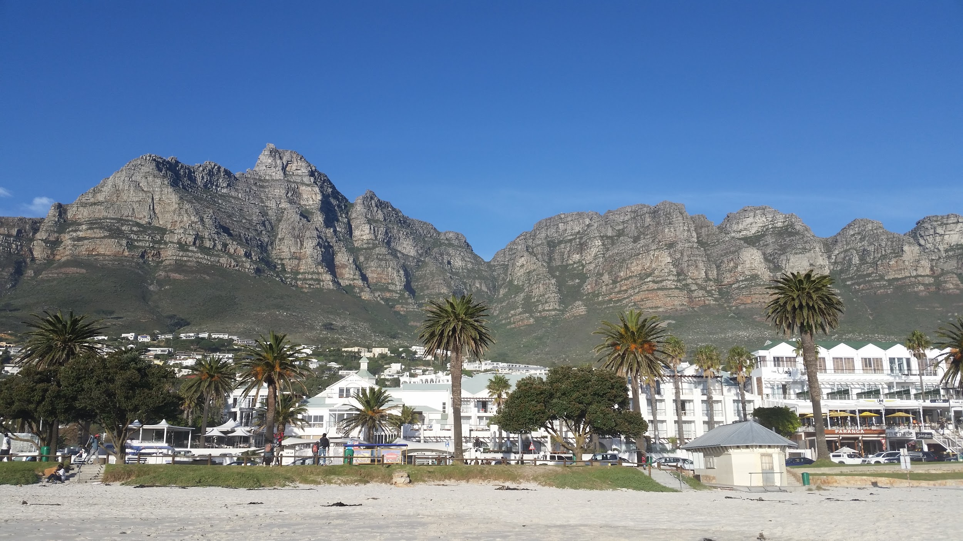
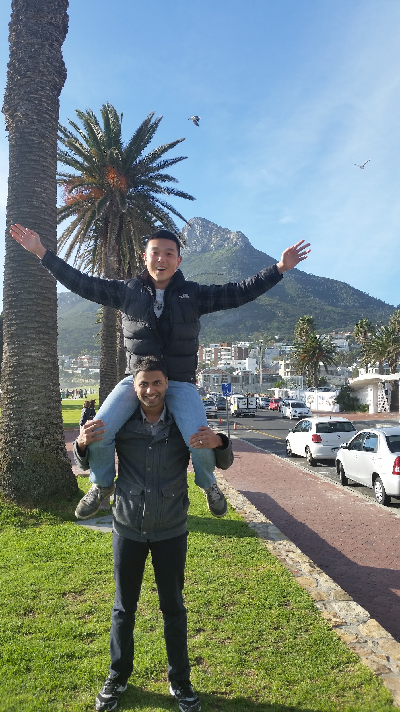
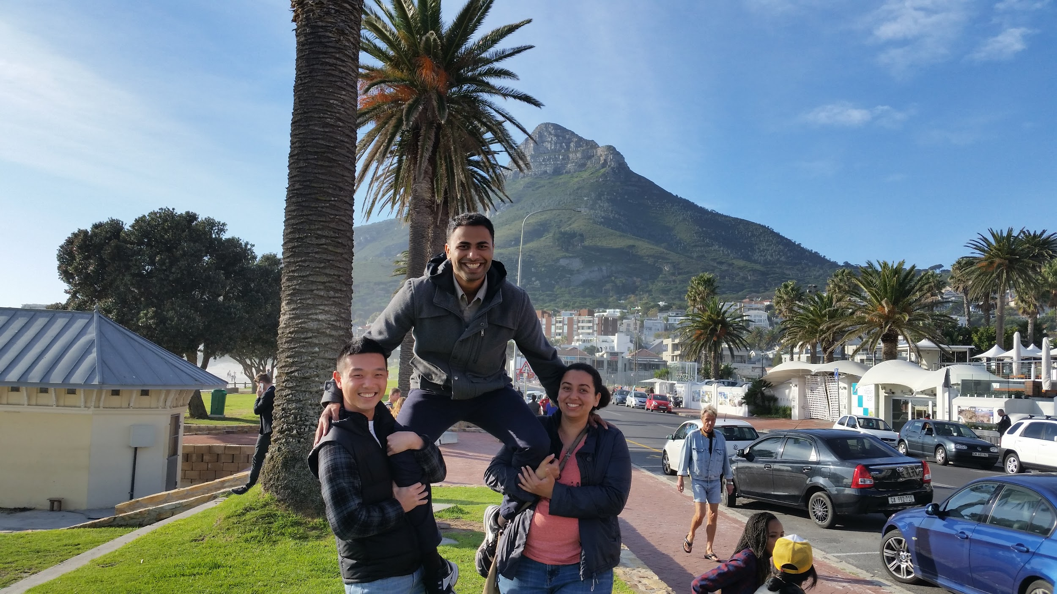
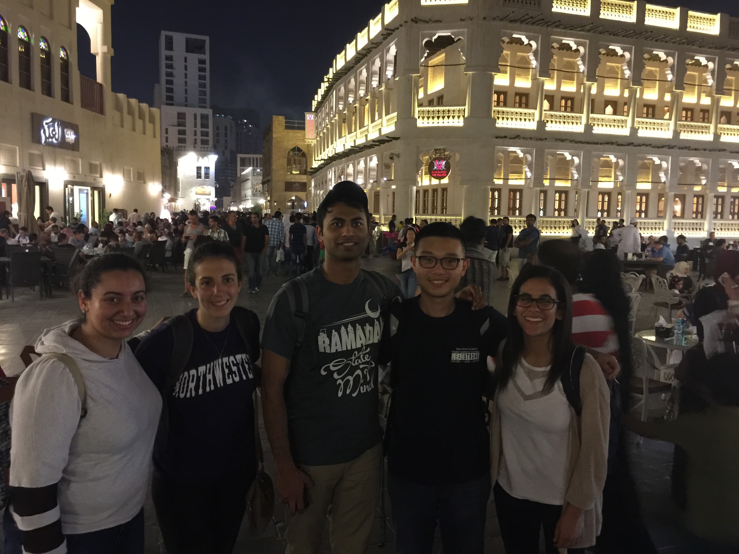

Slide 22
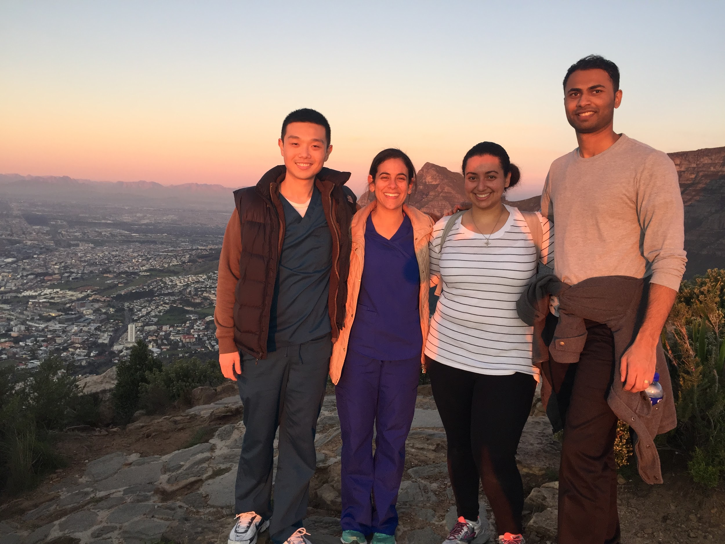

Slide 23
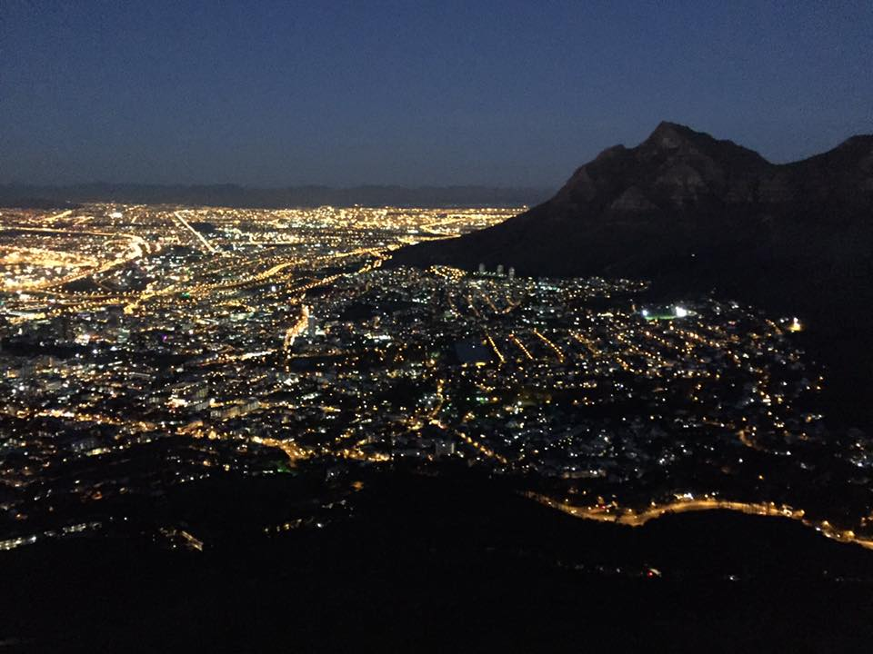

Slide 24
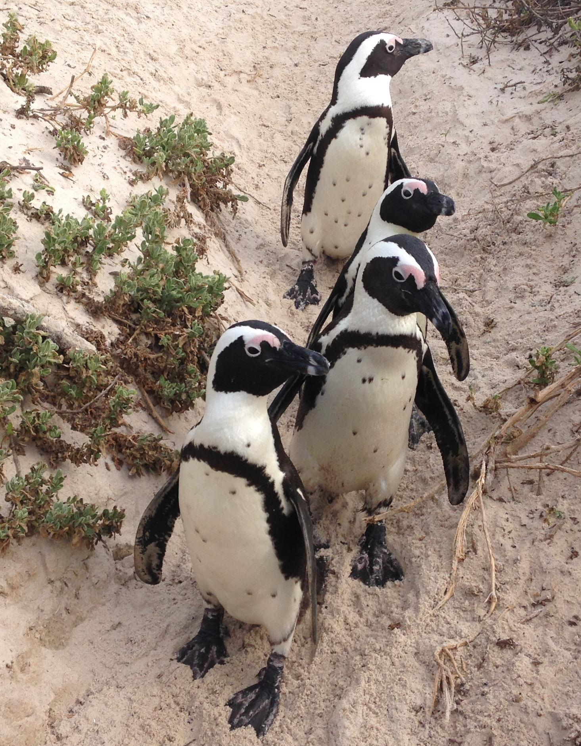
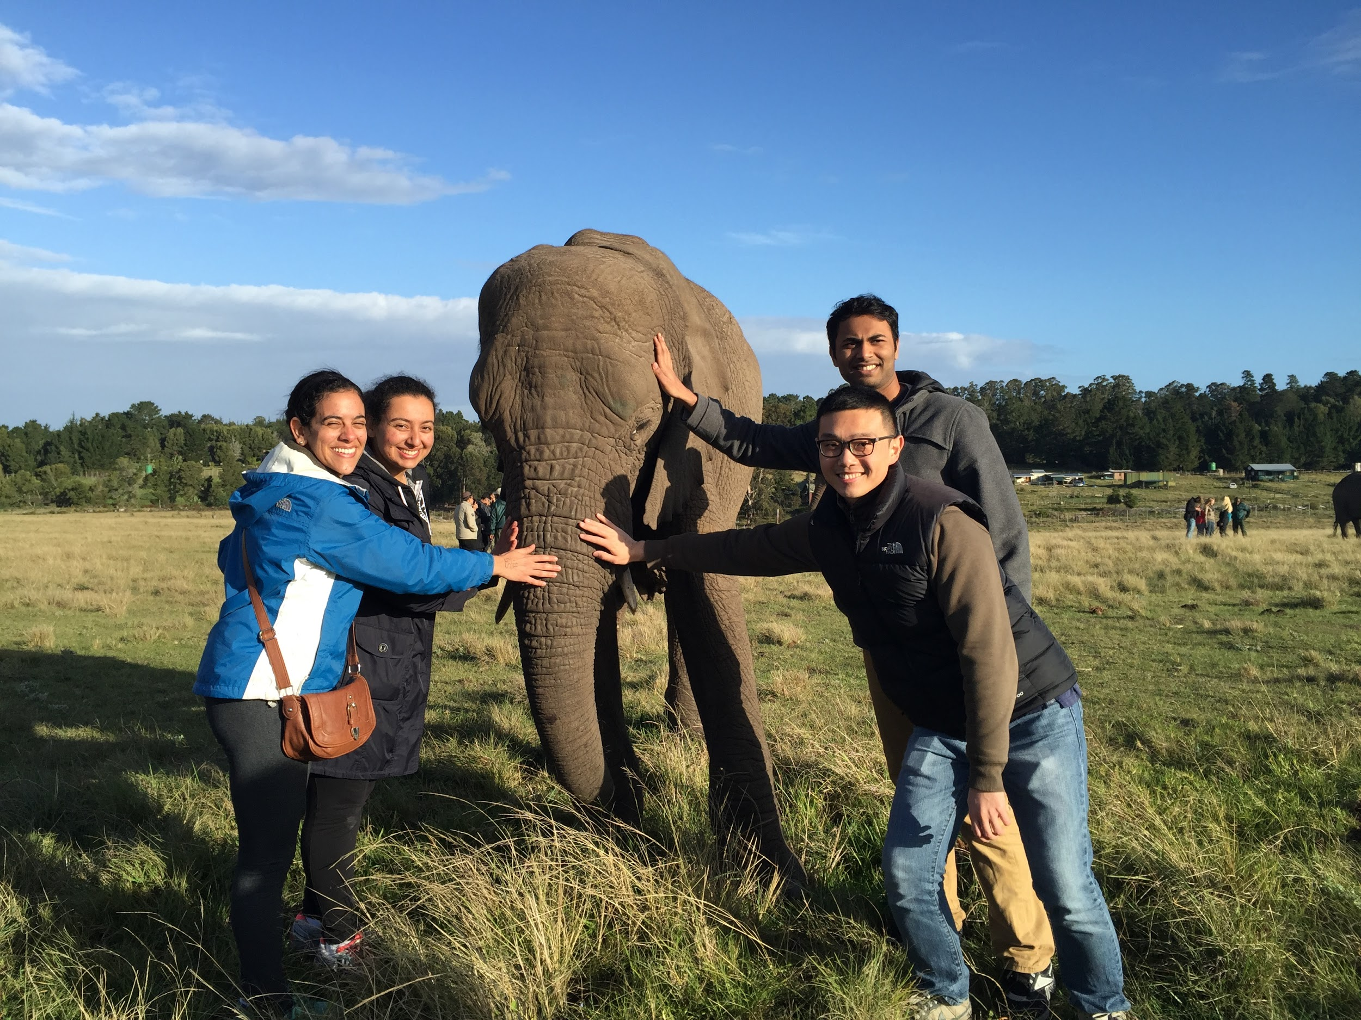
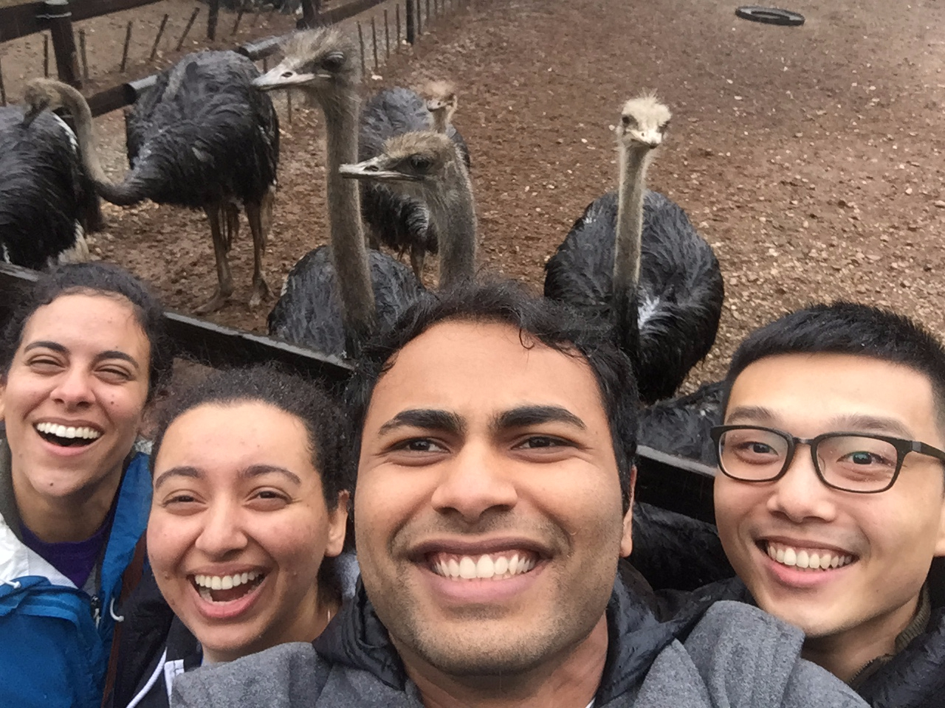
...a few new friends!

Slide 25
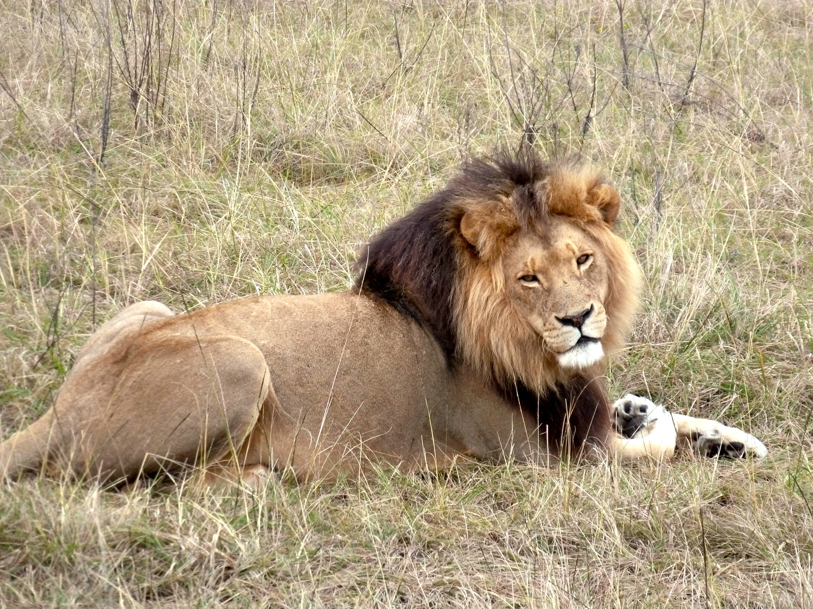
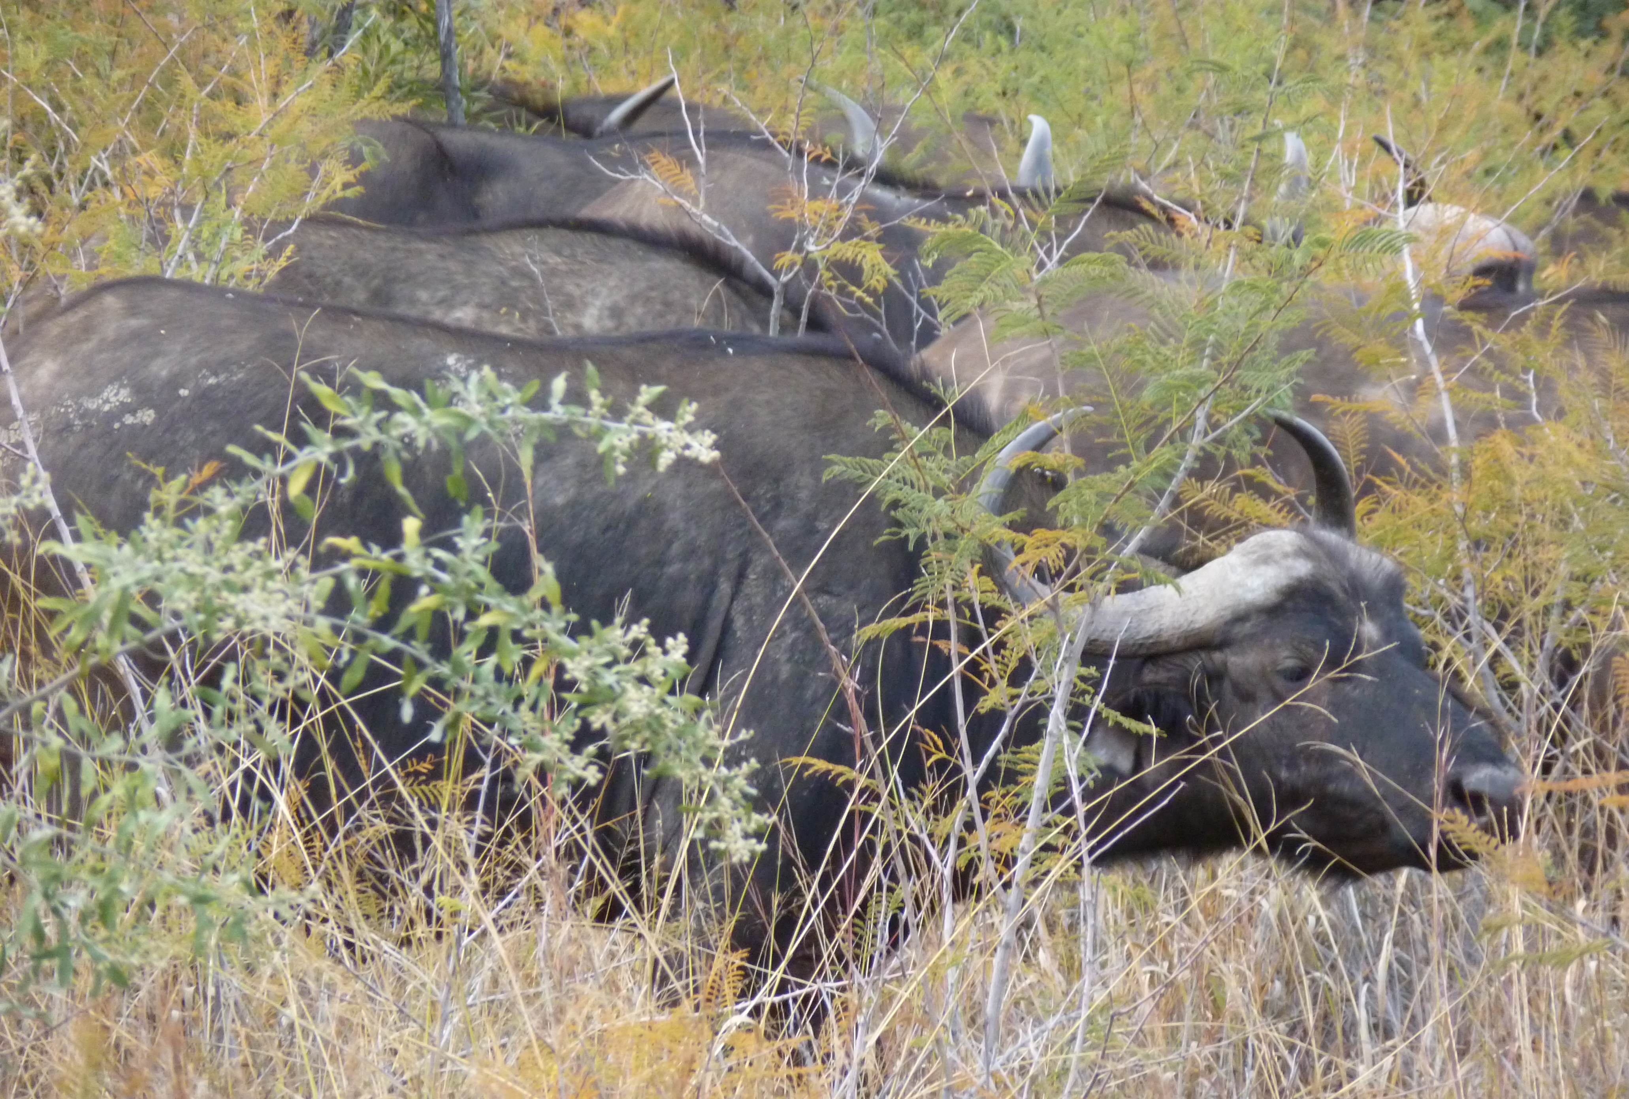
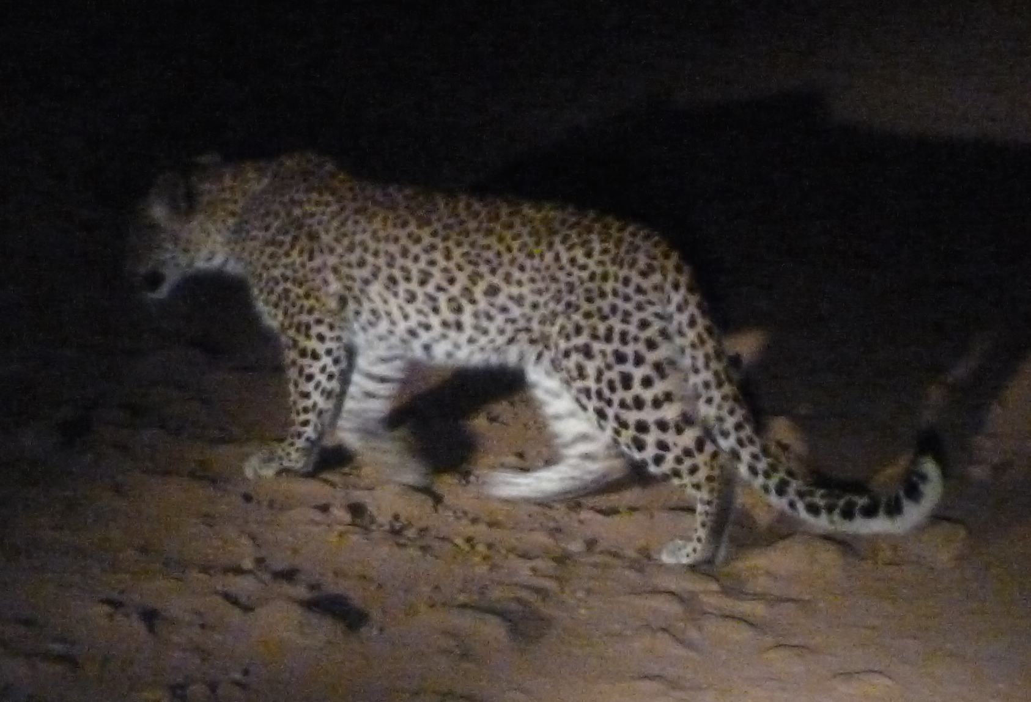
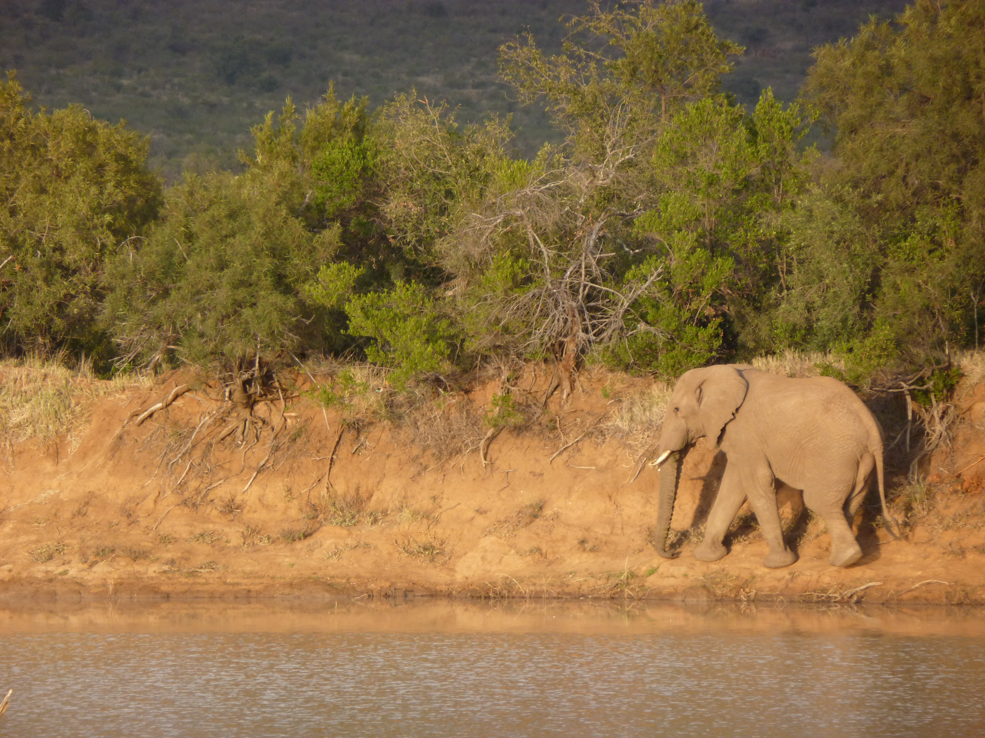
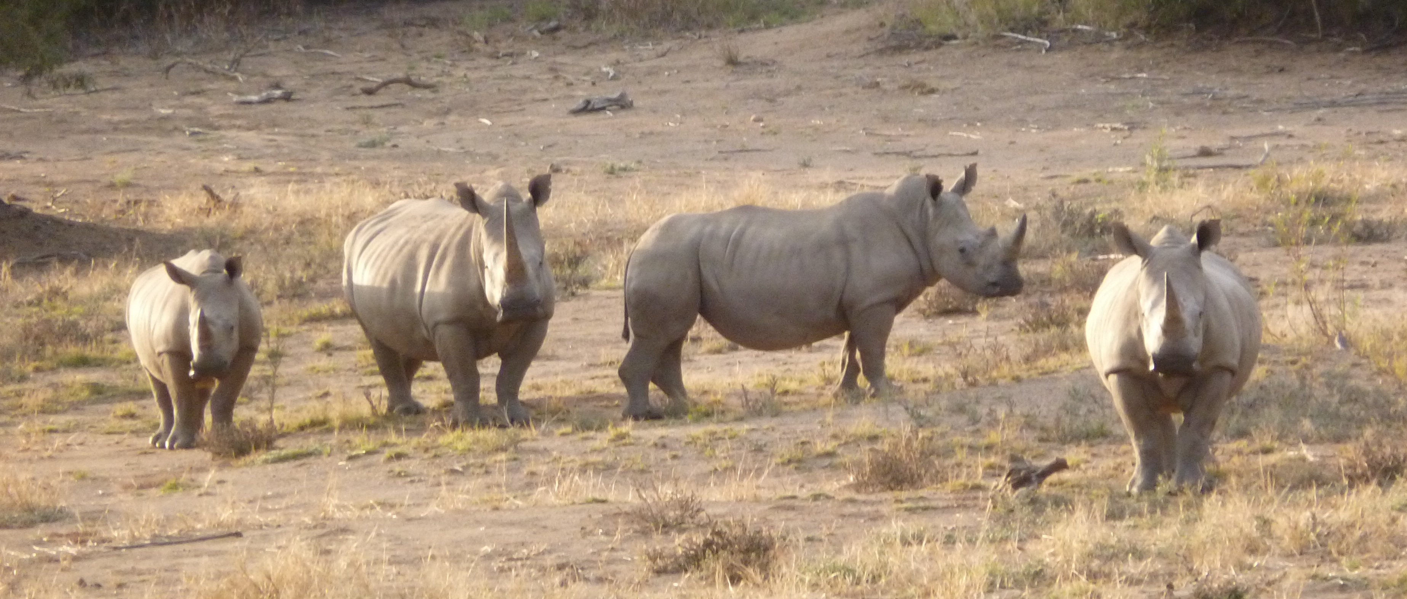
BIG FIVE

Slide 26
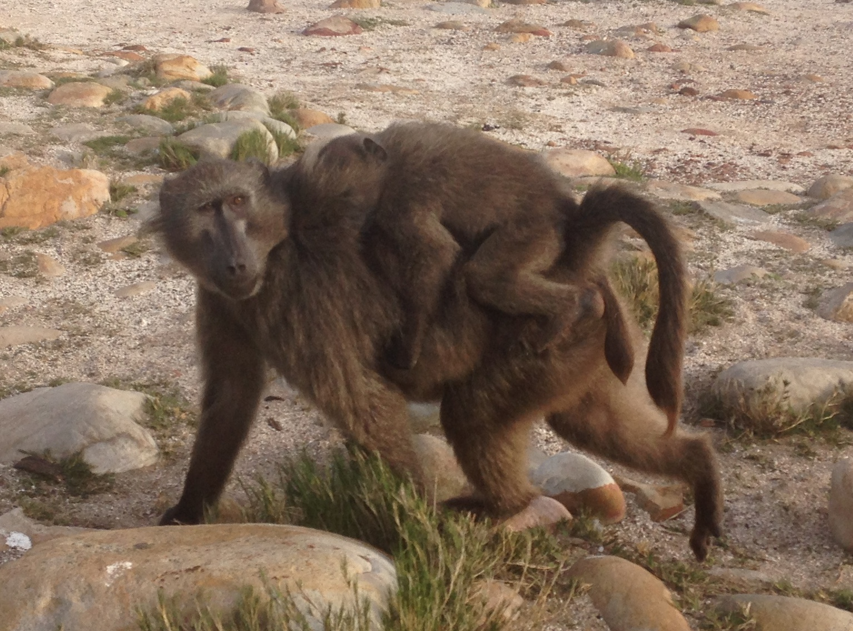
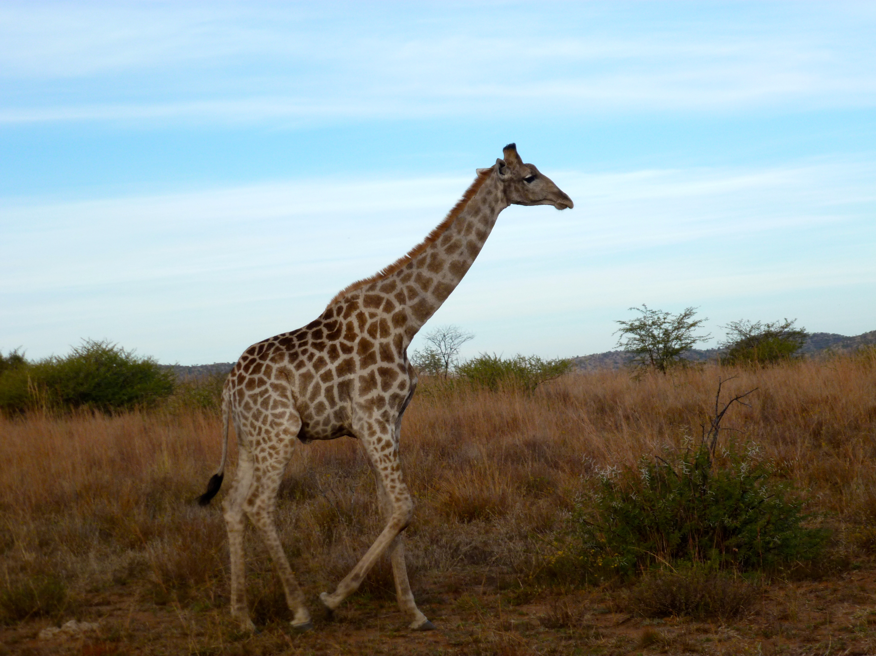
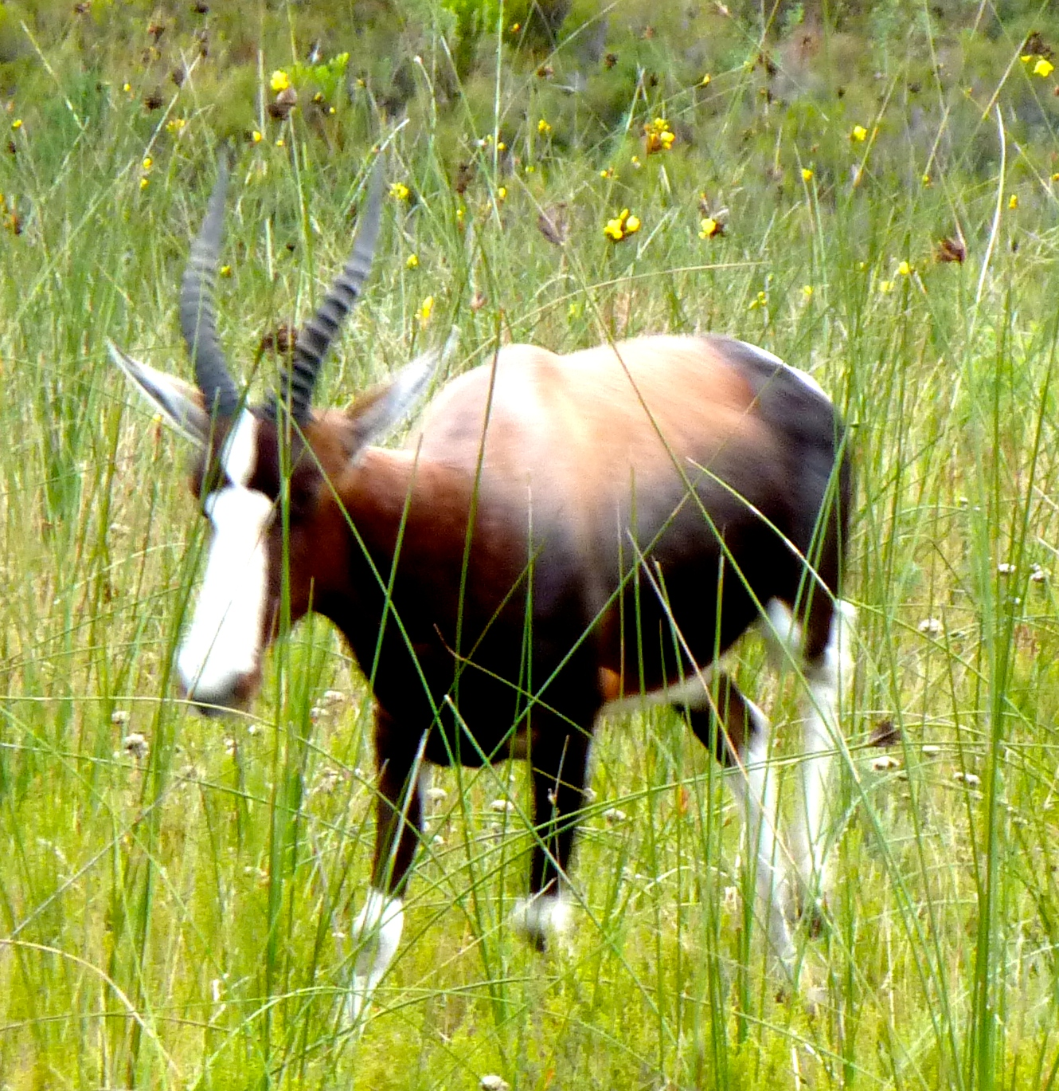
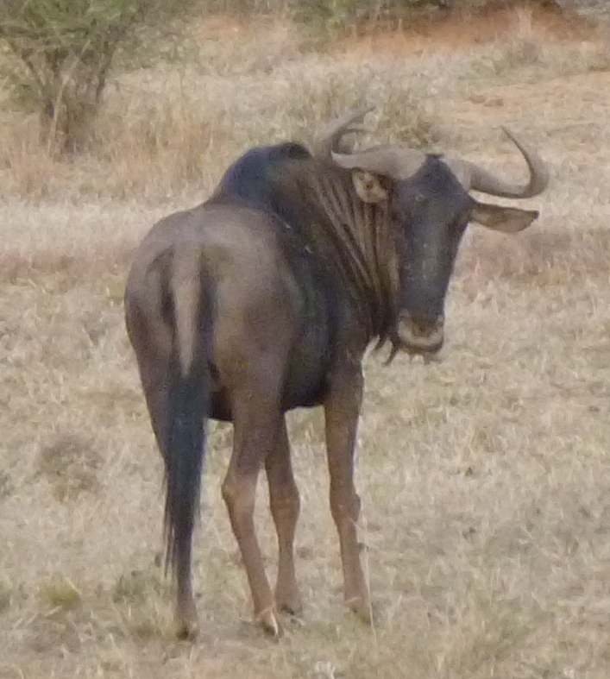
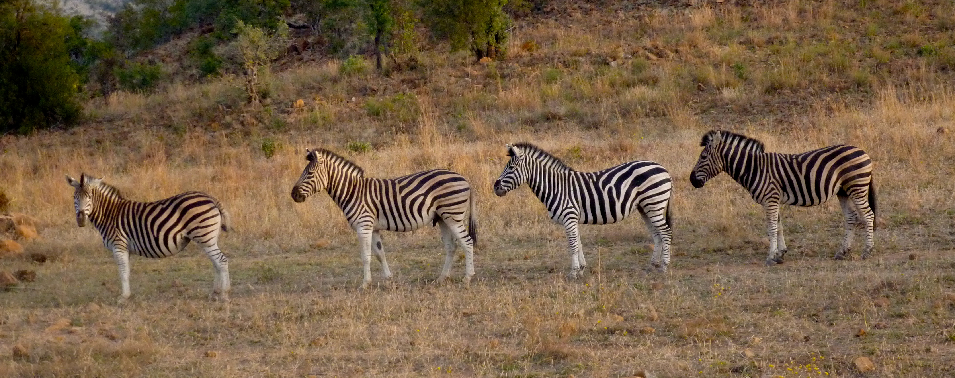
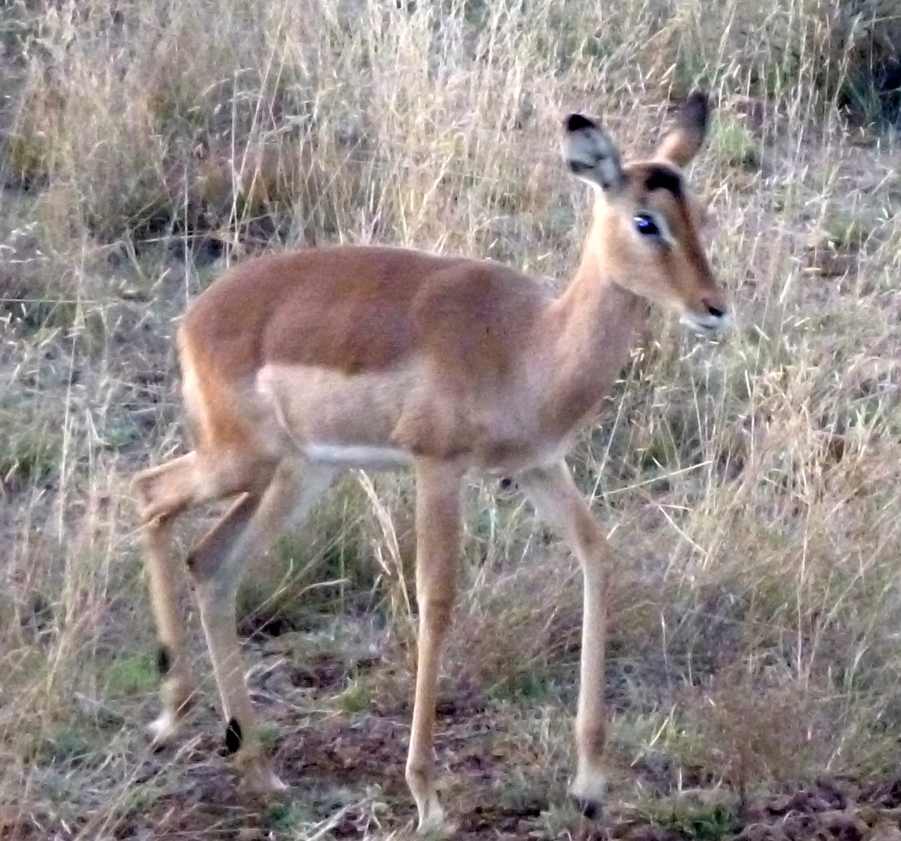

Slide 27
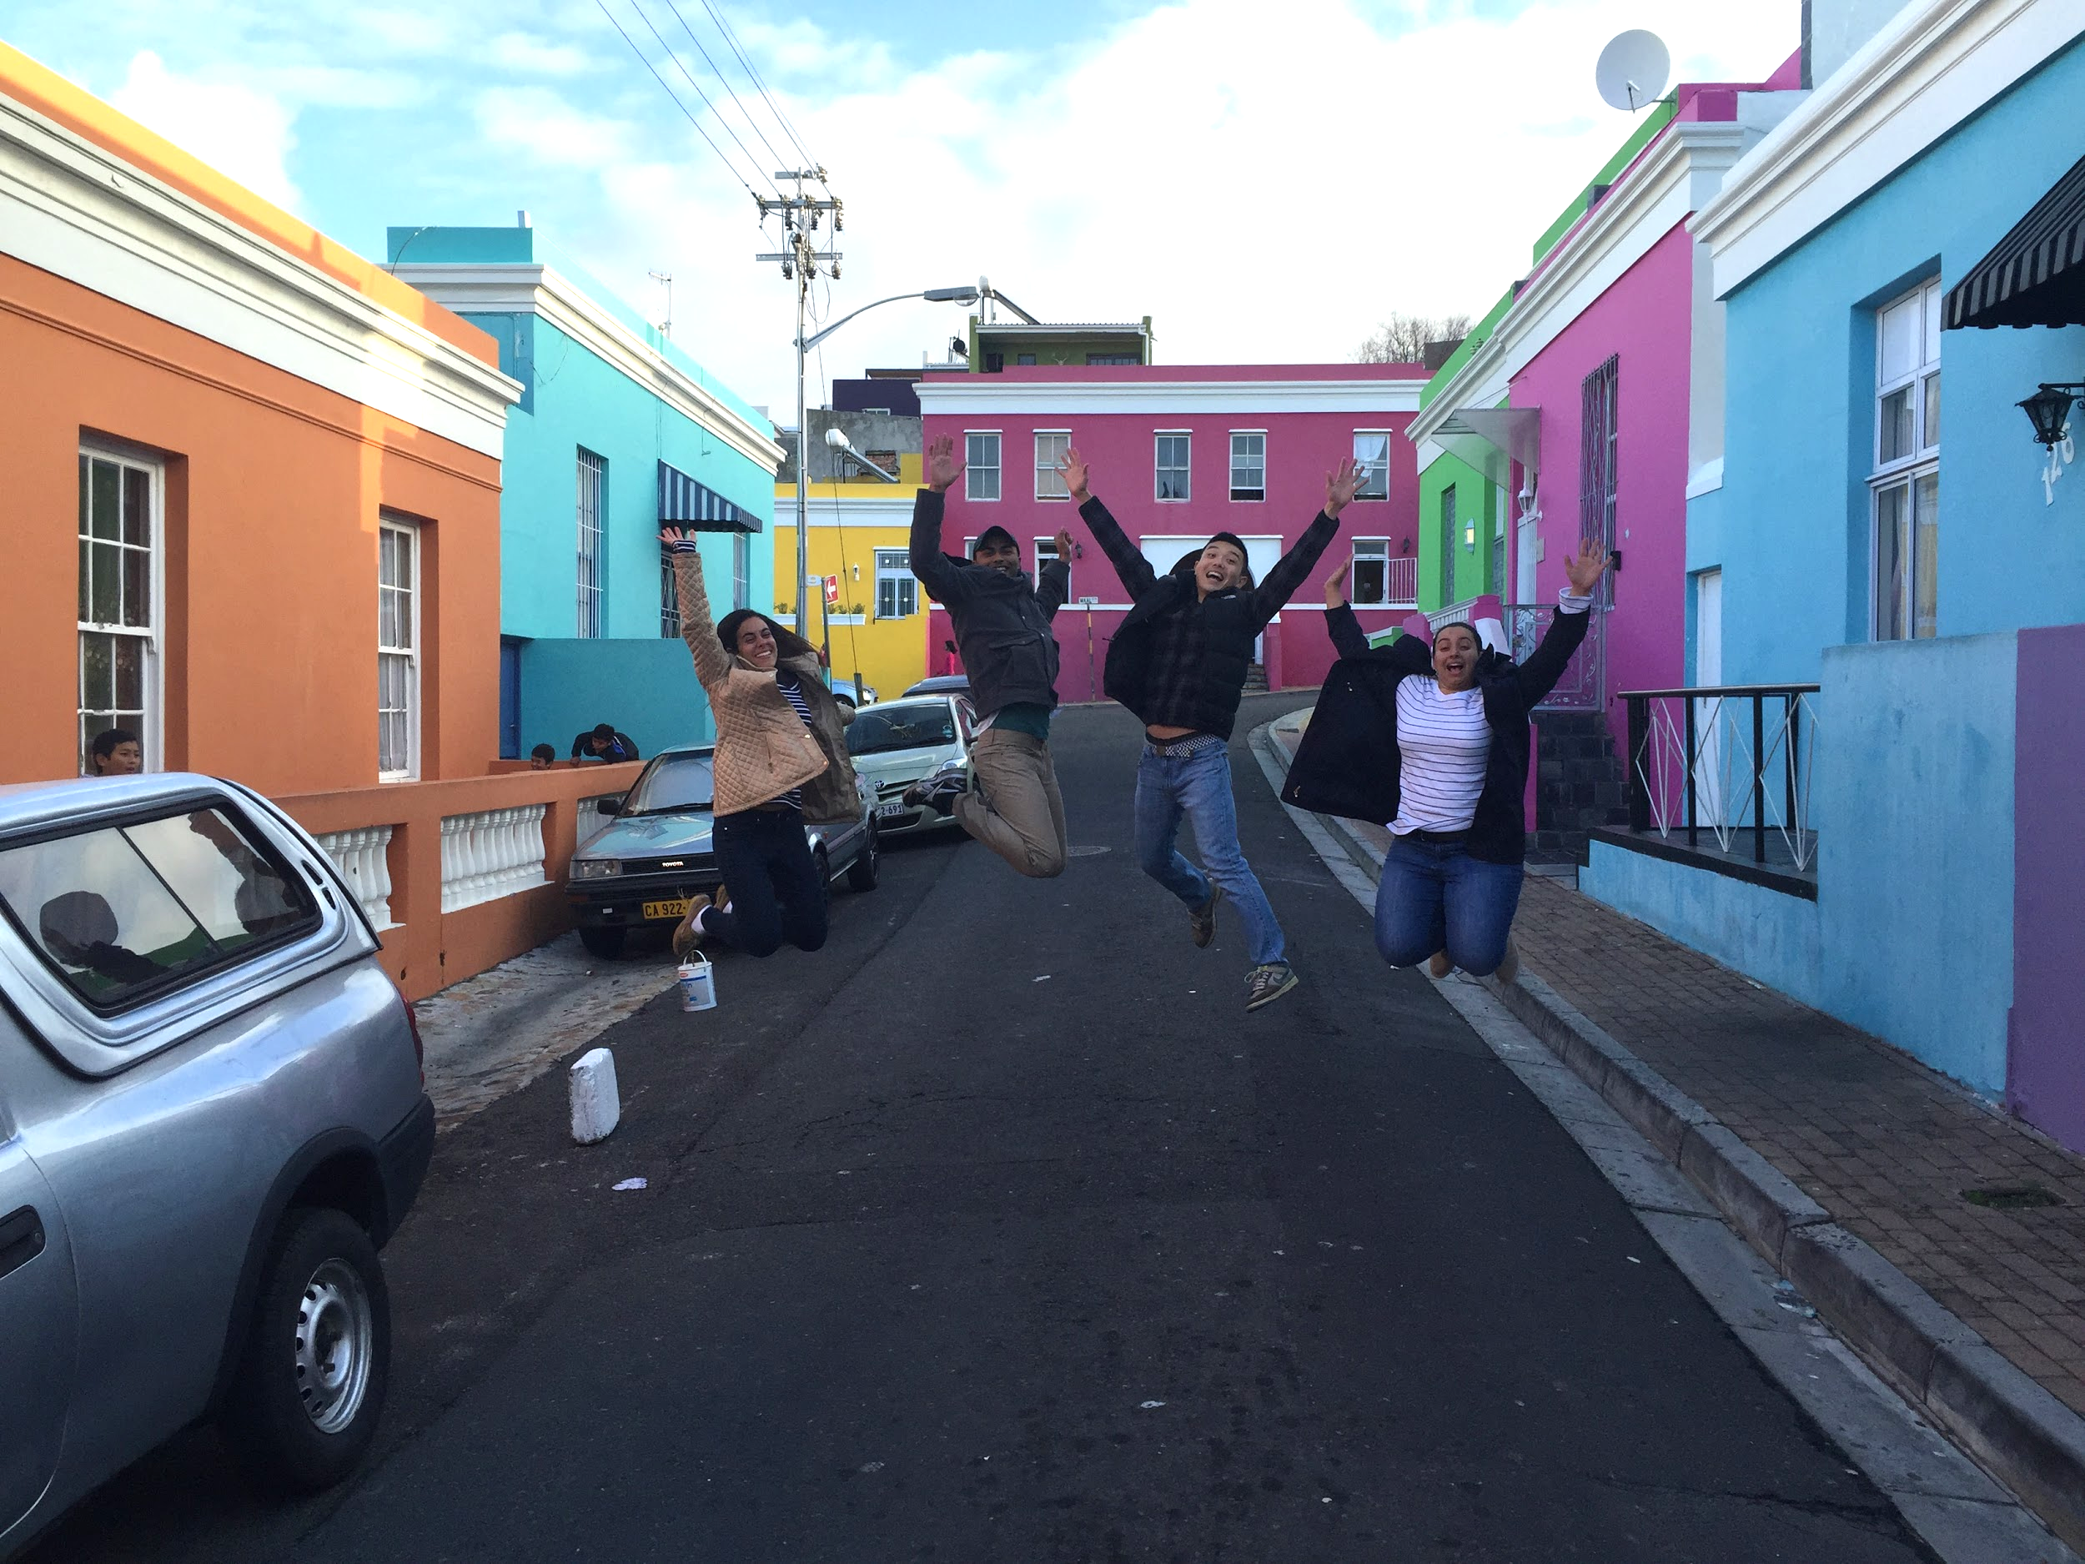

Slide 28
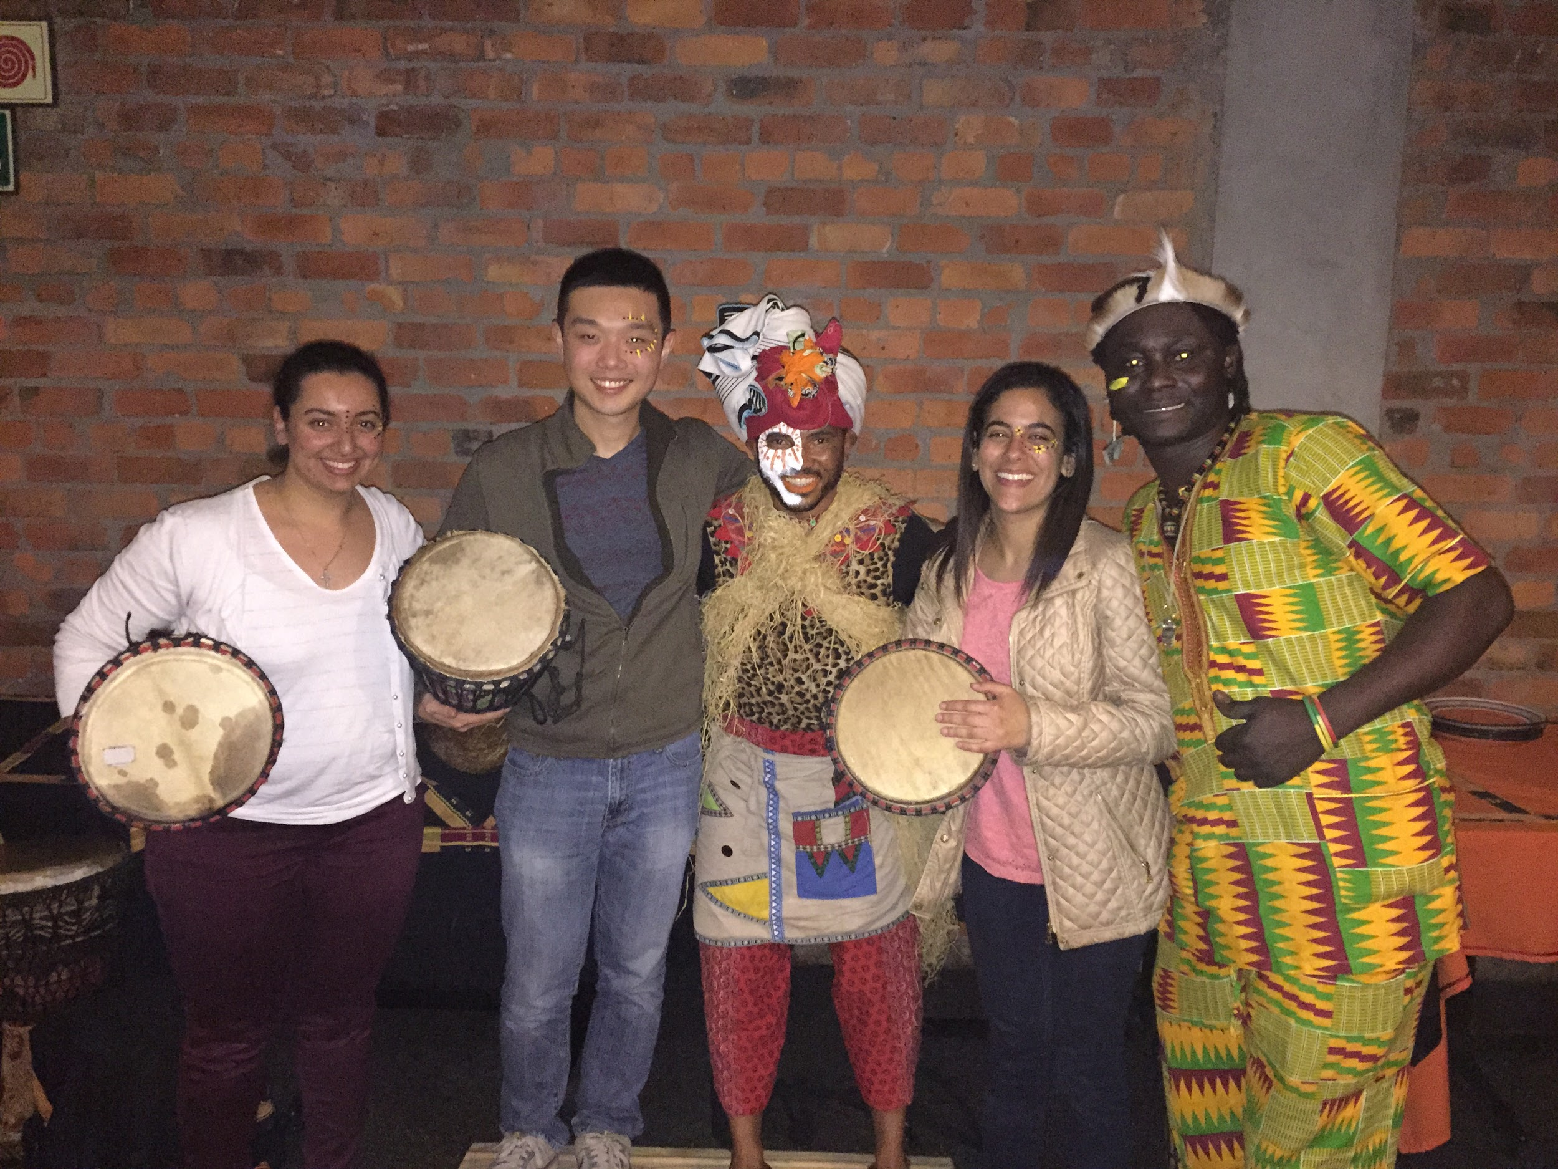
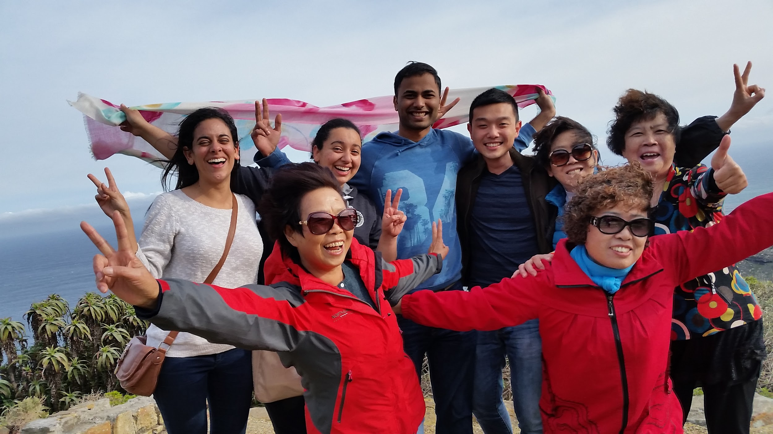
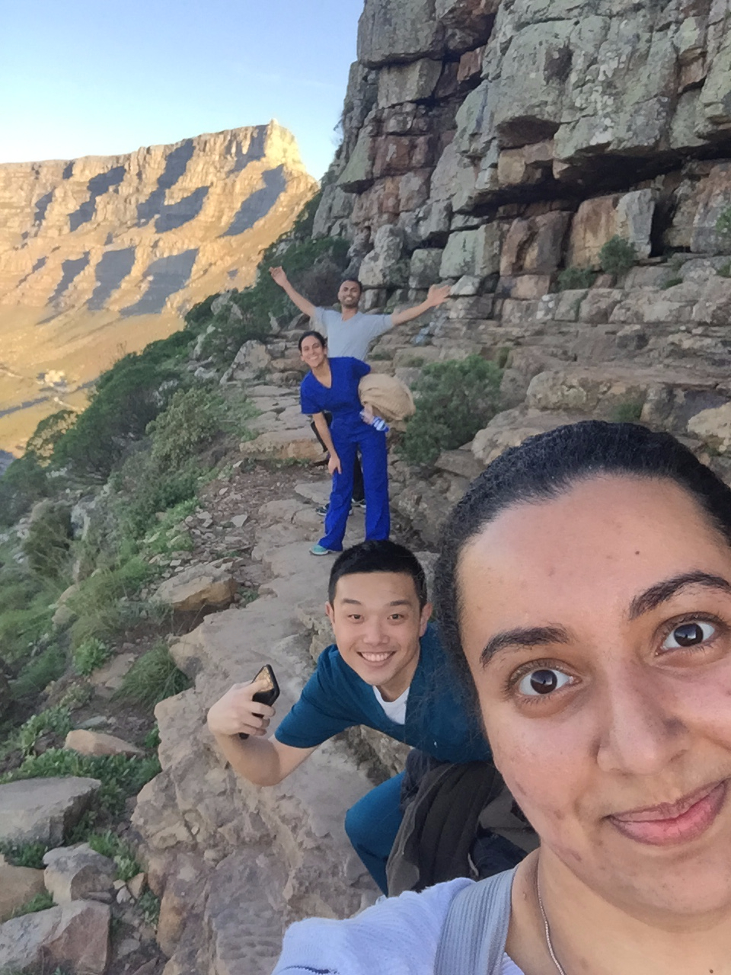
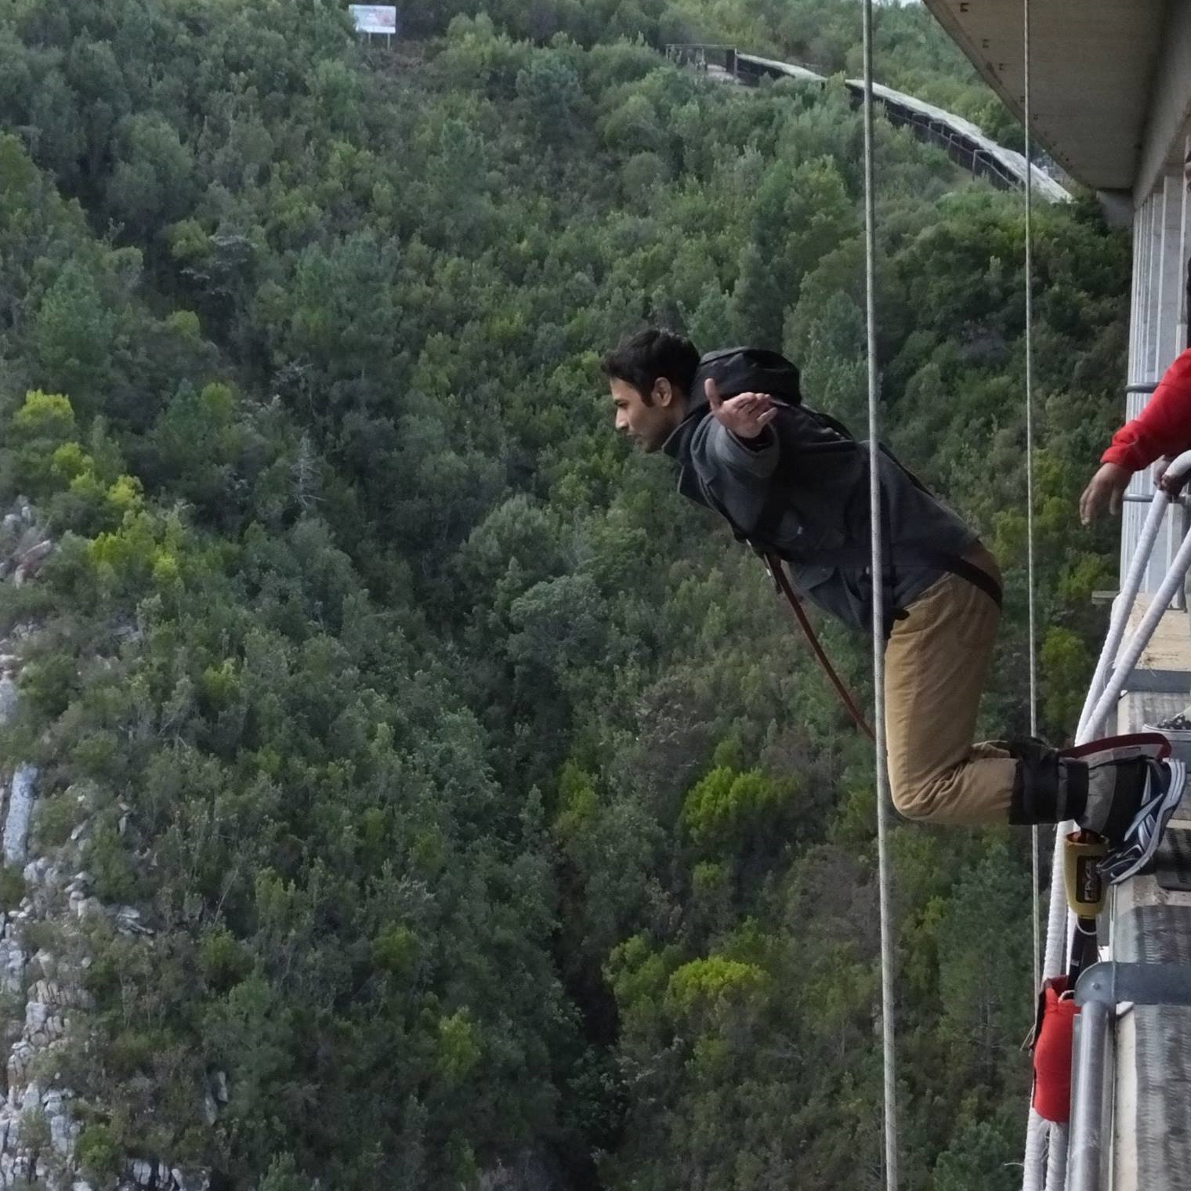
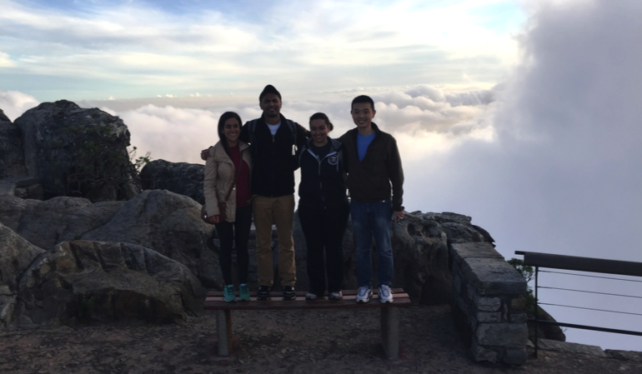
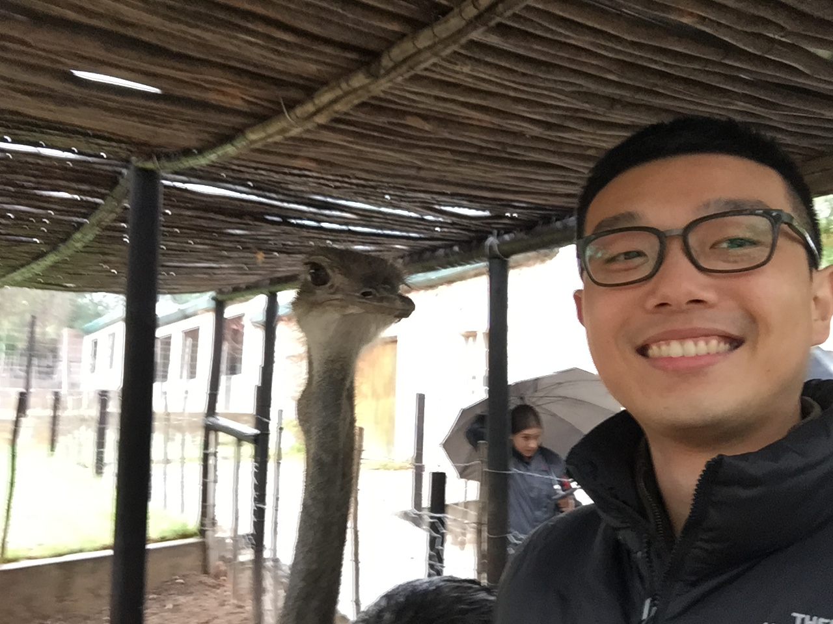

Slide 29
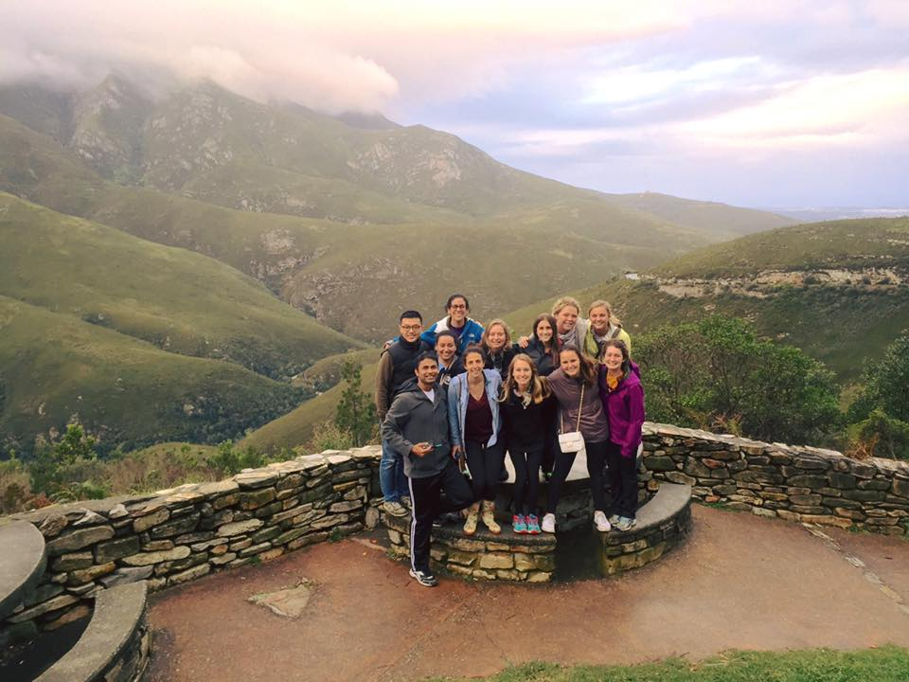

Slide 30
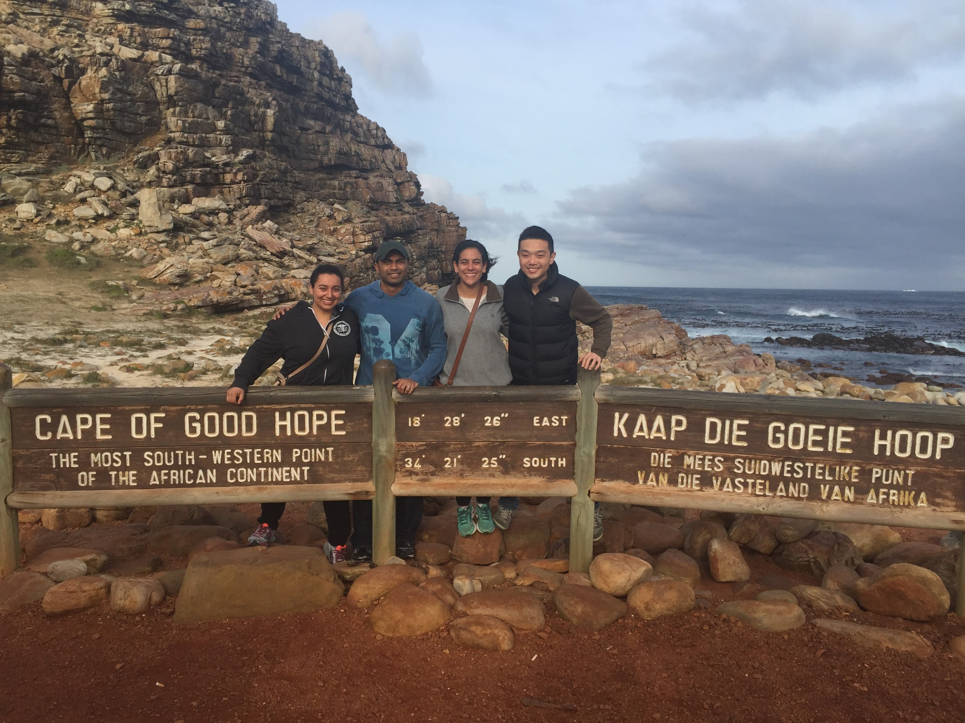

Slide 31
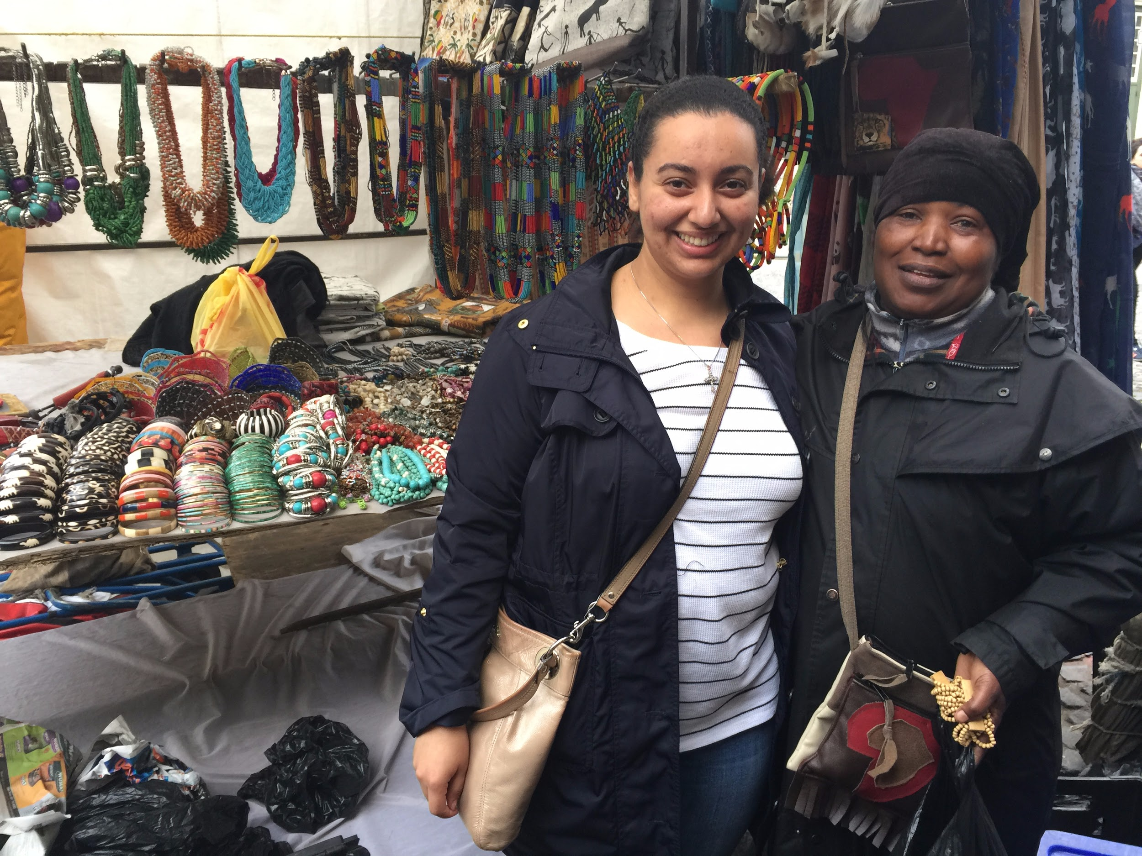
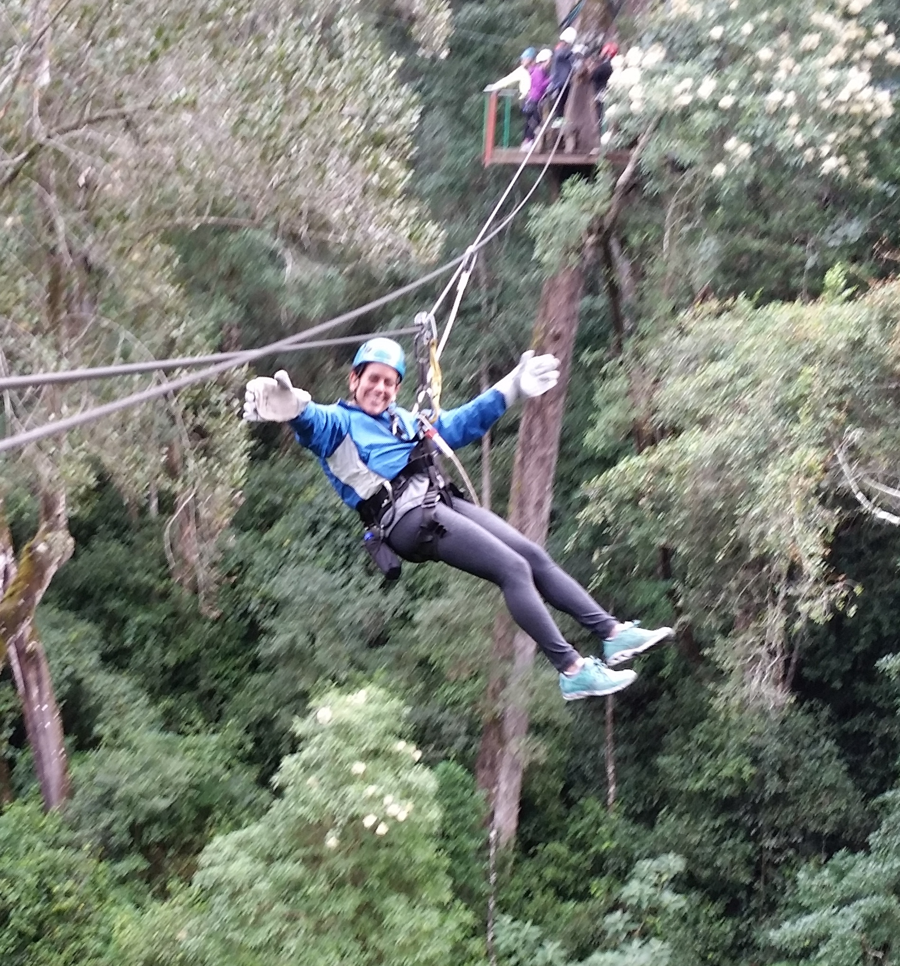
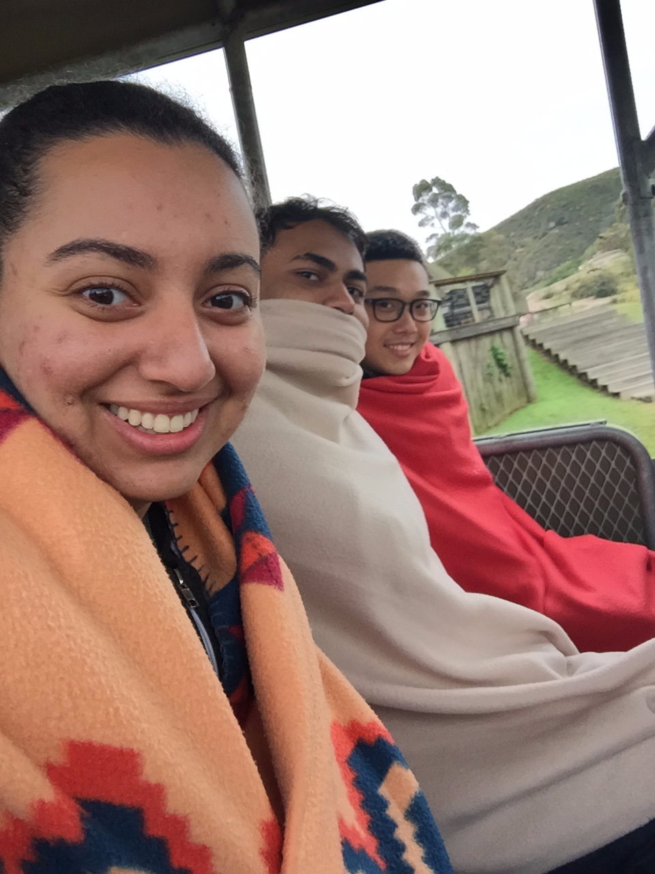

Slide 33
South Africa is LEKKER!

Slide 35
References
Child Family Health International. https://www.cfhi.org. Accessed July 24, 2016.
The history of apartheid in South Africa. http://www-cs-students.stanford.edu/~cale/cs201/apartheid.hist.html. Accessed July 17, 2016.

